Slide 1
Quantitative Research Methods
March 6, 2023
Professor Patrick Rebuschat
p.rebuschat@lancaster.ac.uk
Notes:
Section title slide.

Slide 2
Reminder from last week

Slide 3
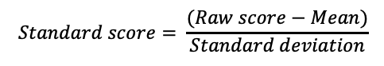
The standard normal distribution and the standard score
Standard normal distribution:
The mean is always 0 and the SD is always 1.
Also known as z-distribution
Standard score:
Number of SDs by which the value of a raw score is above or below the mean value of what is being measured.
Also known as z-score
Both enable us to compare data sets with different means and standard deviations.
$$Standard score= \frac{(Raw score−Mean)}{Standard deviation}$$
Notes:
Both enable us to compare data sets with different means and standard deviations.

Slide 4
Statistical estimation focuses on finding two estimates.
Point estimate
The point estimate is our best guess of the population parameter.
For example: We often use M as our point estimate of μ.
Interval estimate
We calculate an interval estimate to determine how close our point estimate (M) is likely to be to the population value (μ).
The interval estimate tells us the precision of our point estimate.
Notes:
Then, we calculate a CI to tell us the precision of our estimate – how close M is likely to be to the unknown μ.
The point estimate of the population parameter and an interval estimate of that parameter to signal how close our point estimate is likely to be to the population value.
M is our point estimate, the CI tells us the precision of our estimate, how close M is likely to be to the unknown population mean

Slide 5
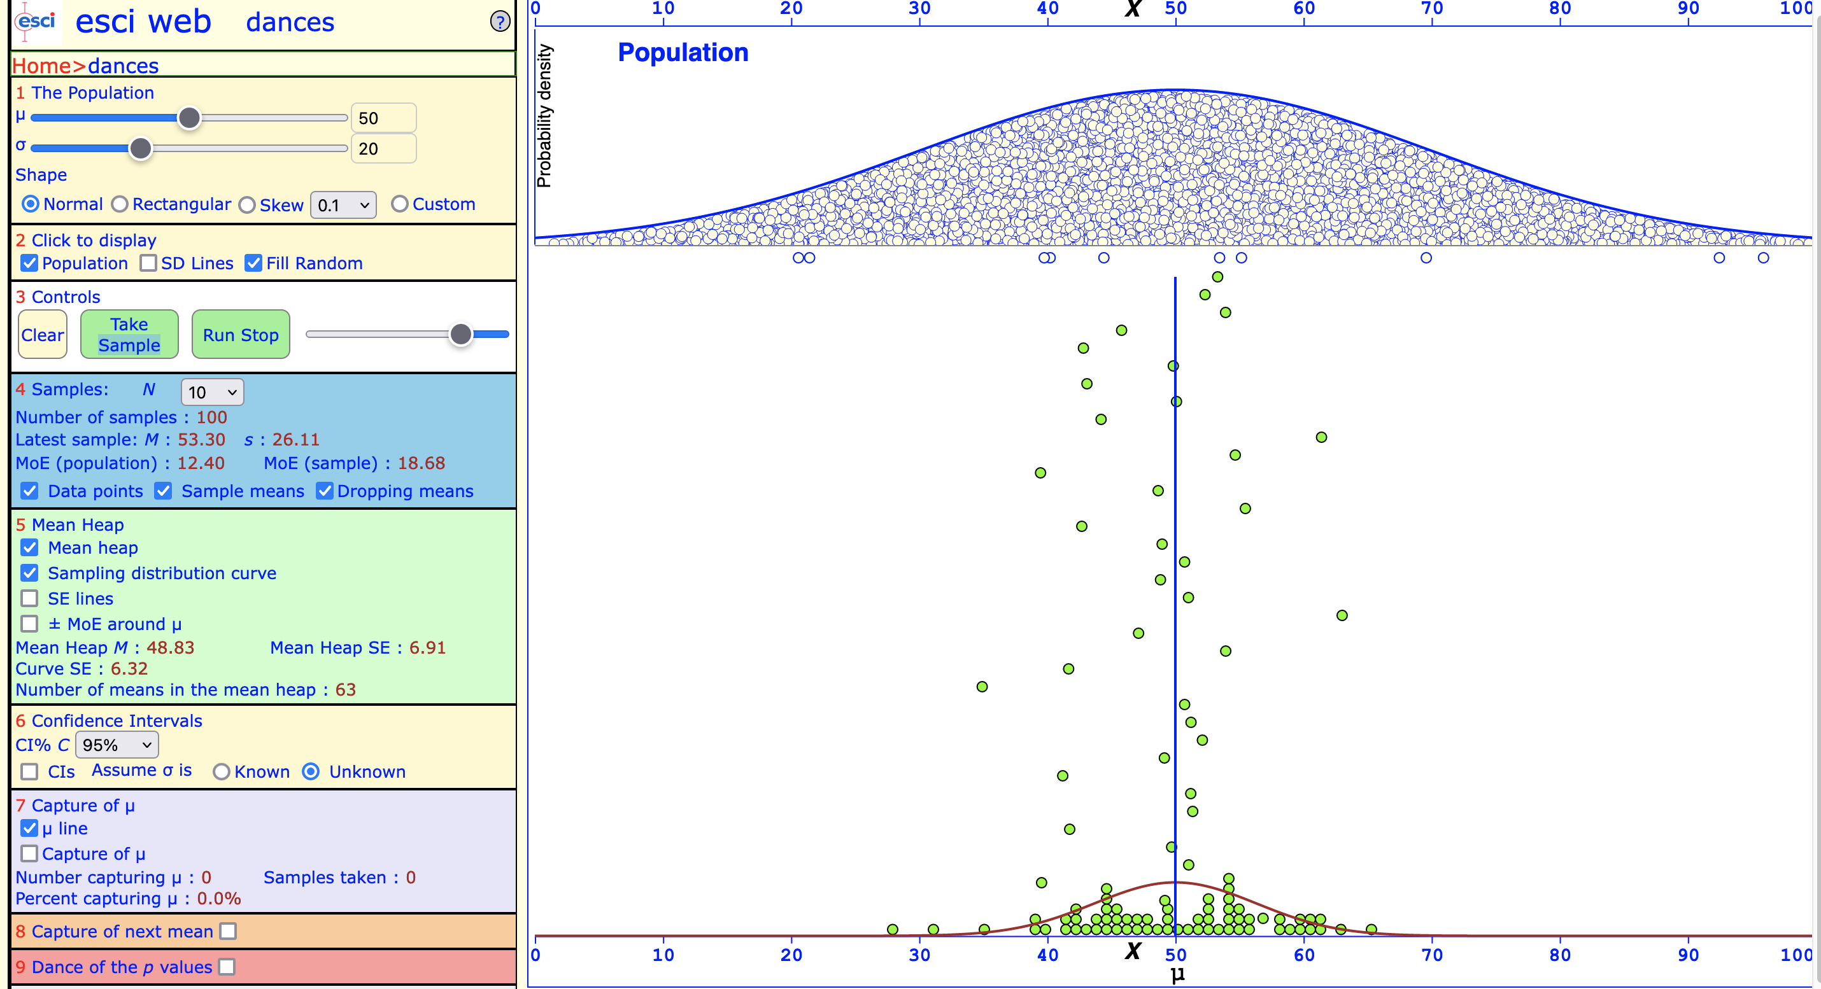
Exuberant dance: μ = 50, σ = 20, N = 10
Text
N = 10

Slide 6
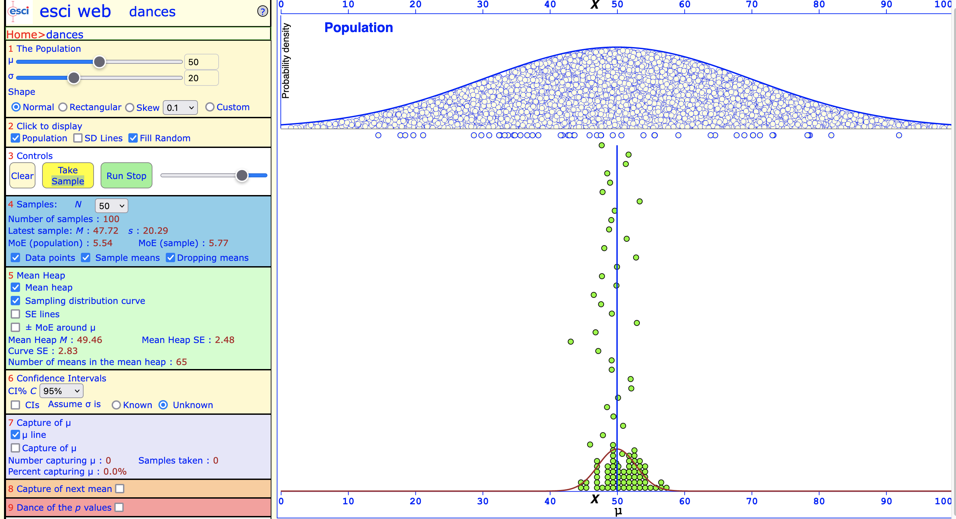
Sober dance: μ = 50, σ = 20, N = 50
Text
N = 50

Slide 7
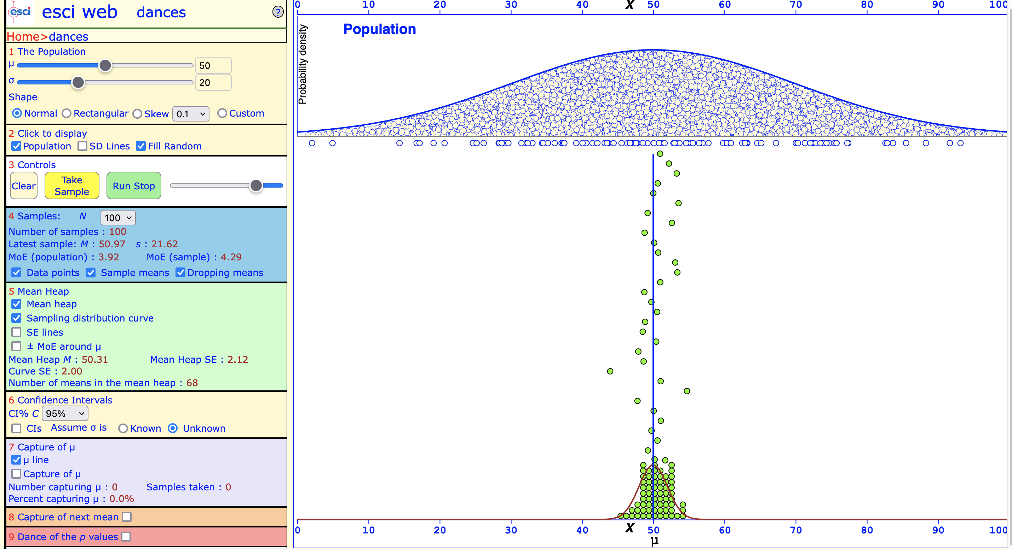
Very sober dance: μ = 50, σ = 20, N = 100
Text
N = 100

Slide 8
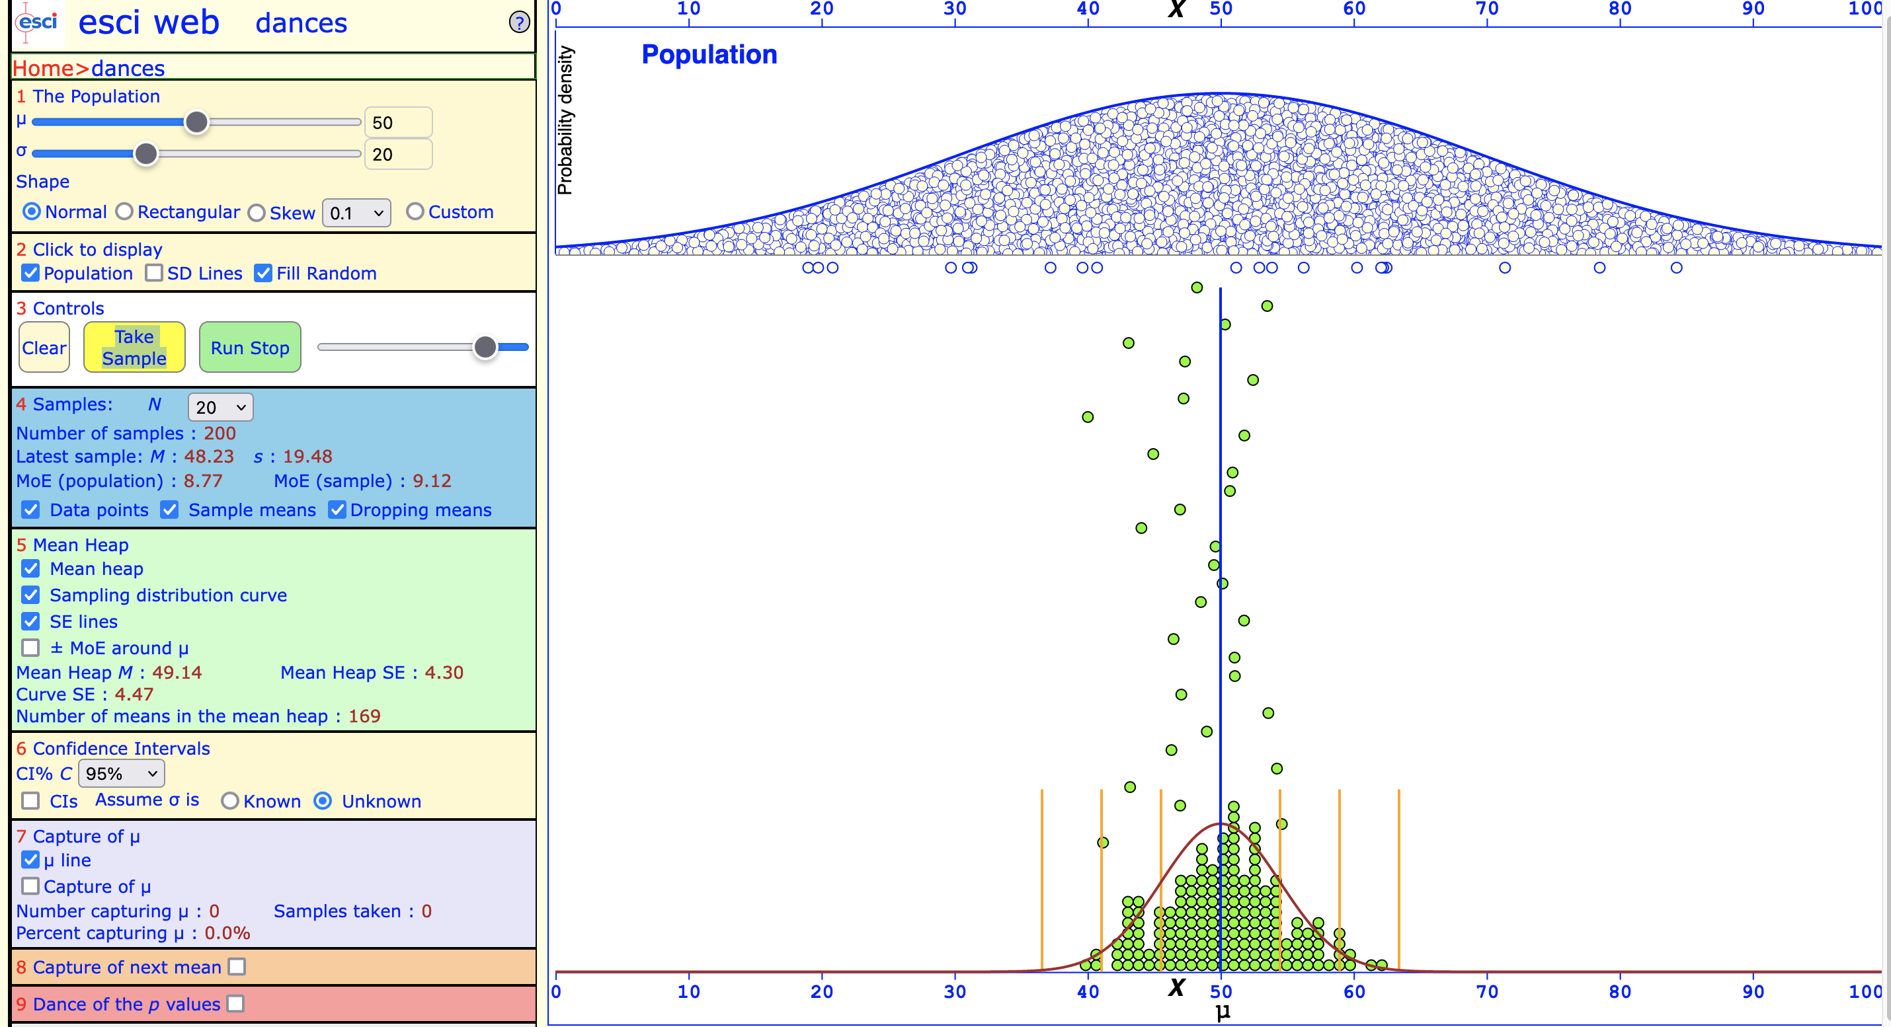
μ = 50, σ = 20, N = 20
Text
σ = 20

Slide 9
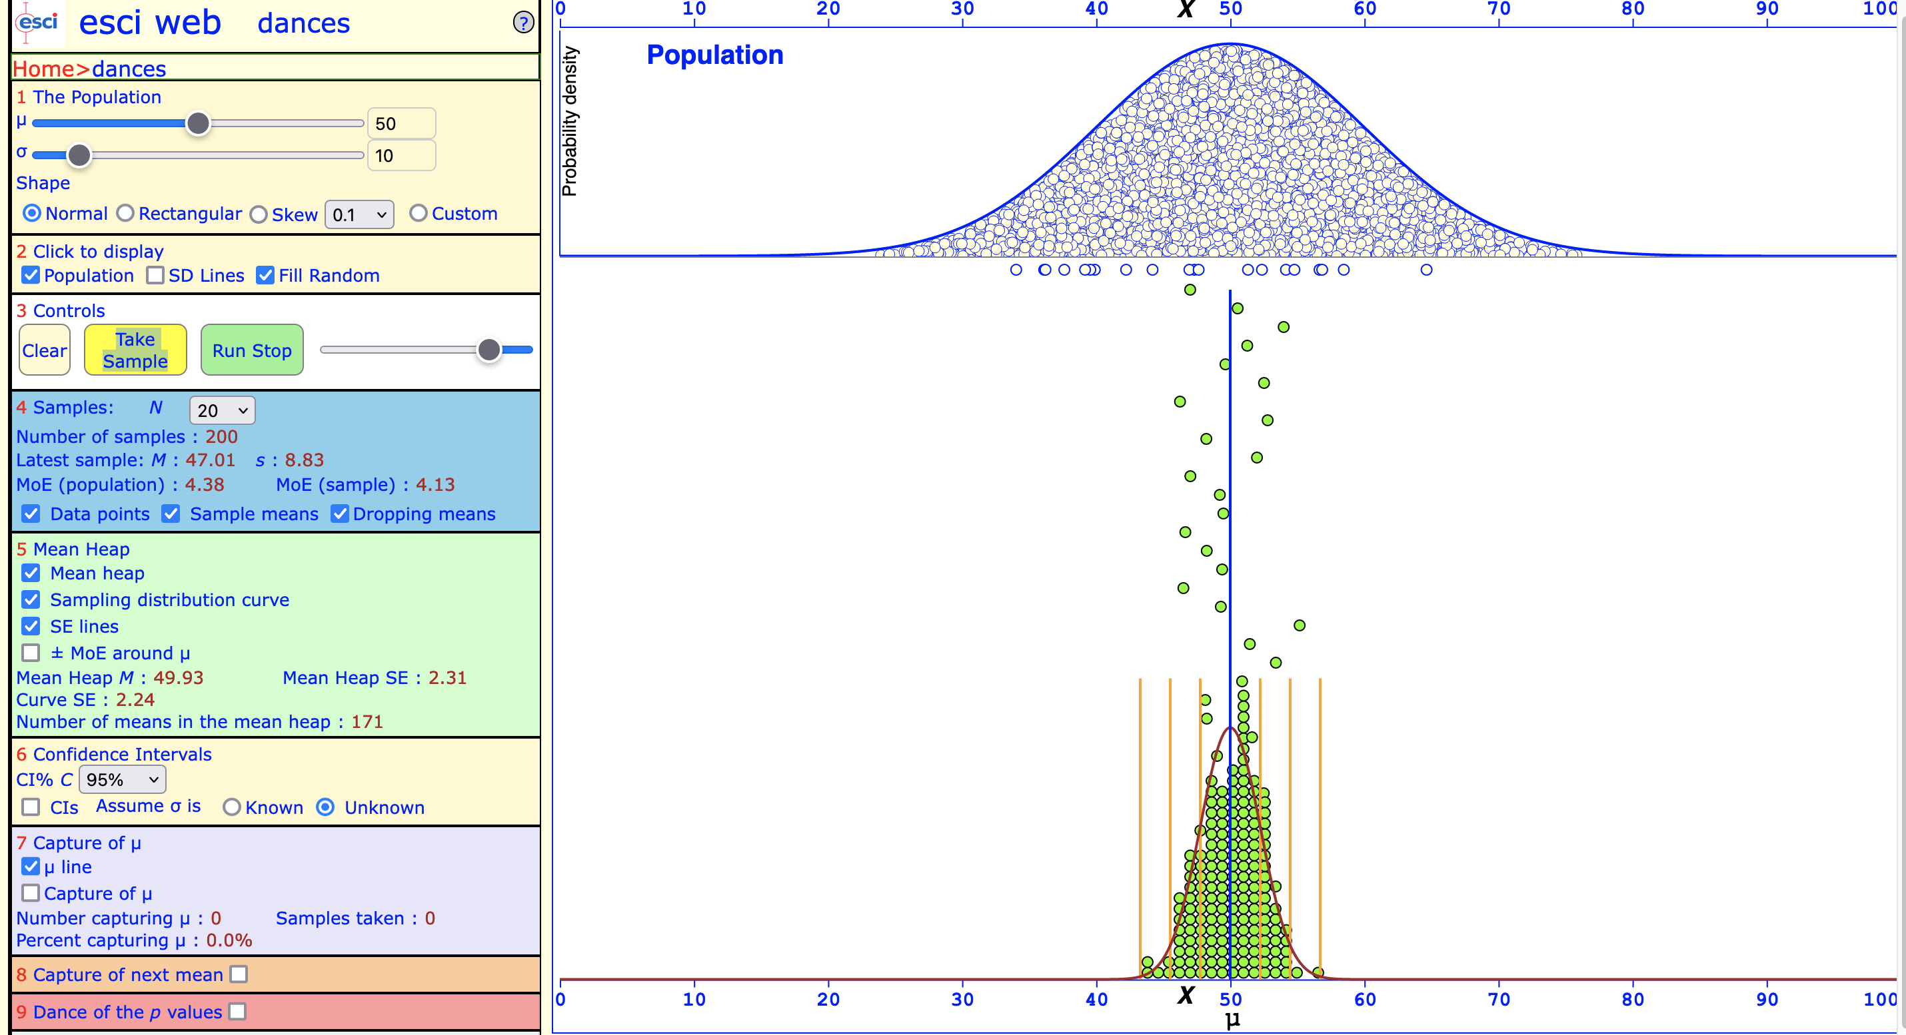
μ = 50, σ = 10, N = 20
Text
σ = 10

Slide 10
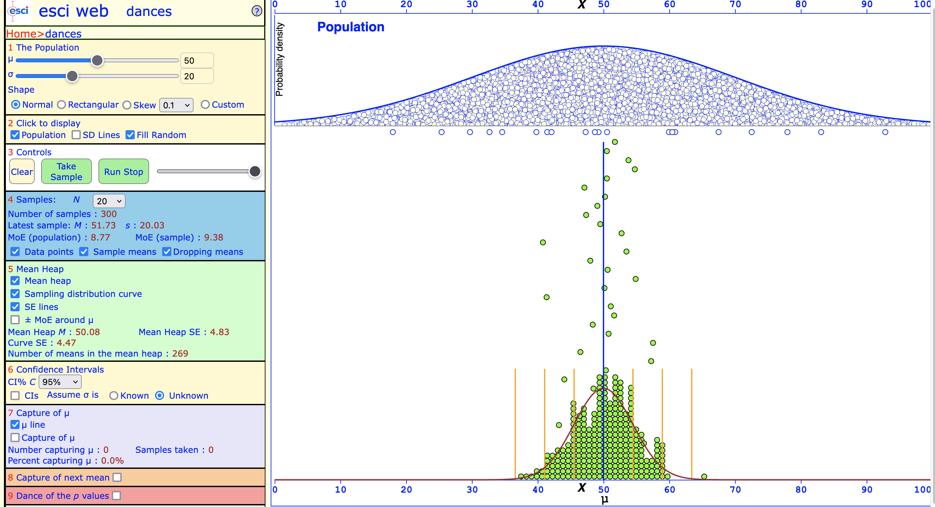
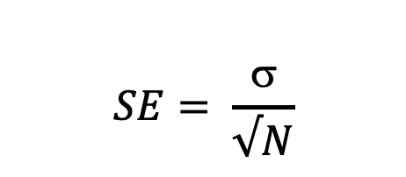
Standard error
$$SE= \frac{\text{σ}}{√N}$$
Standard error lines (SD of sampling distribution)
👉
👈
Notes:
Turn on SE in ESCI. Broad mean heap = large SE, imprecise estimates

Slide 11
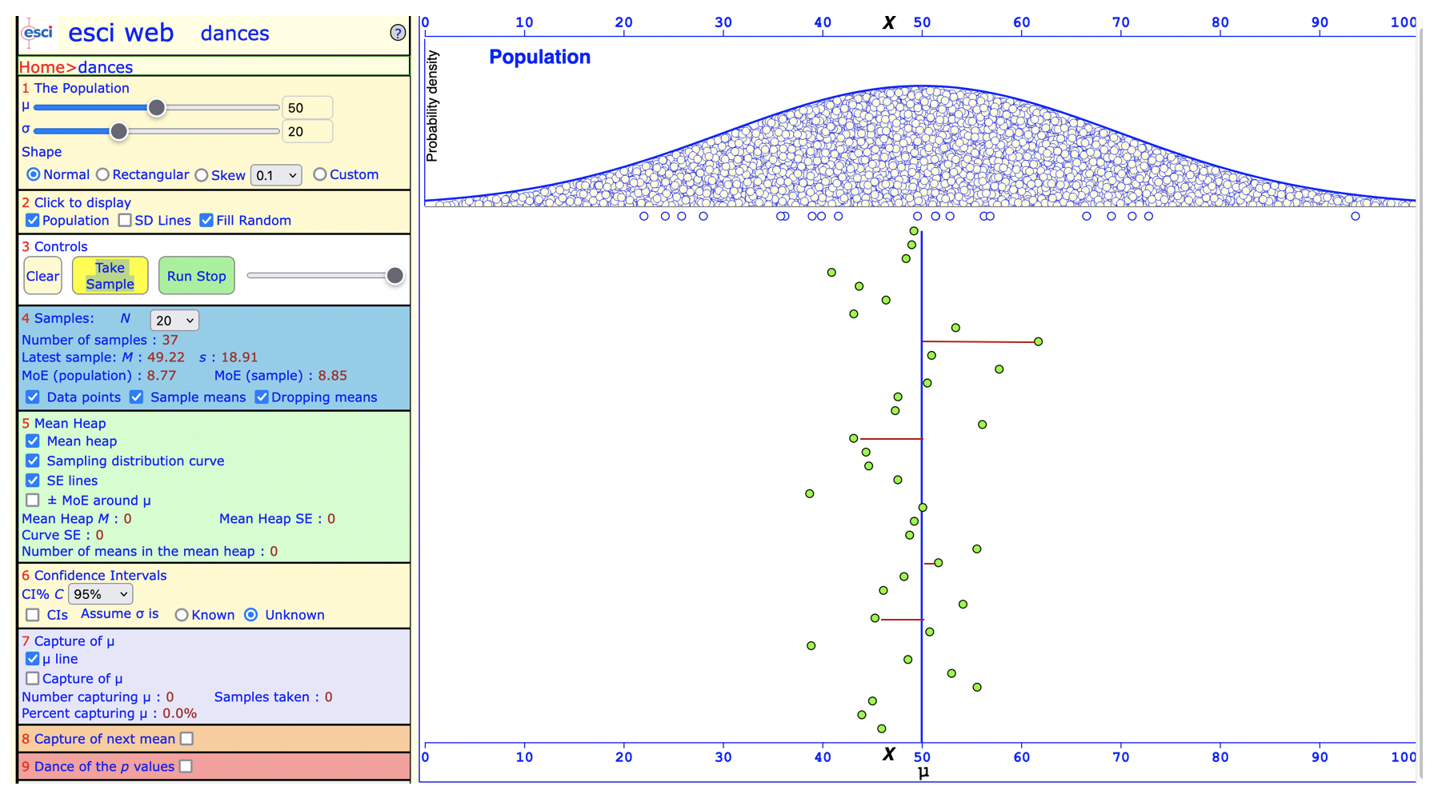
Error of estimation (M – μ)
The distance from the M “bubble” to the μ line.
👉
THE EE from sample to sample, i.e. from green bubble to green bubble.
Notes:
This varies from sample to sample (see dance of means).

Slide 12
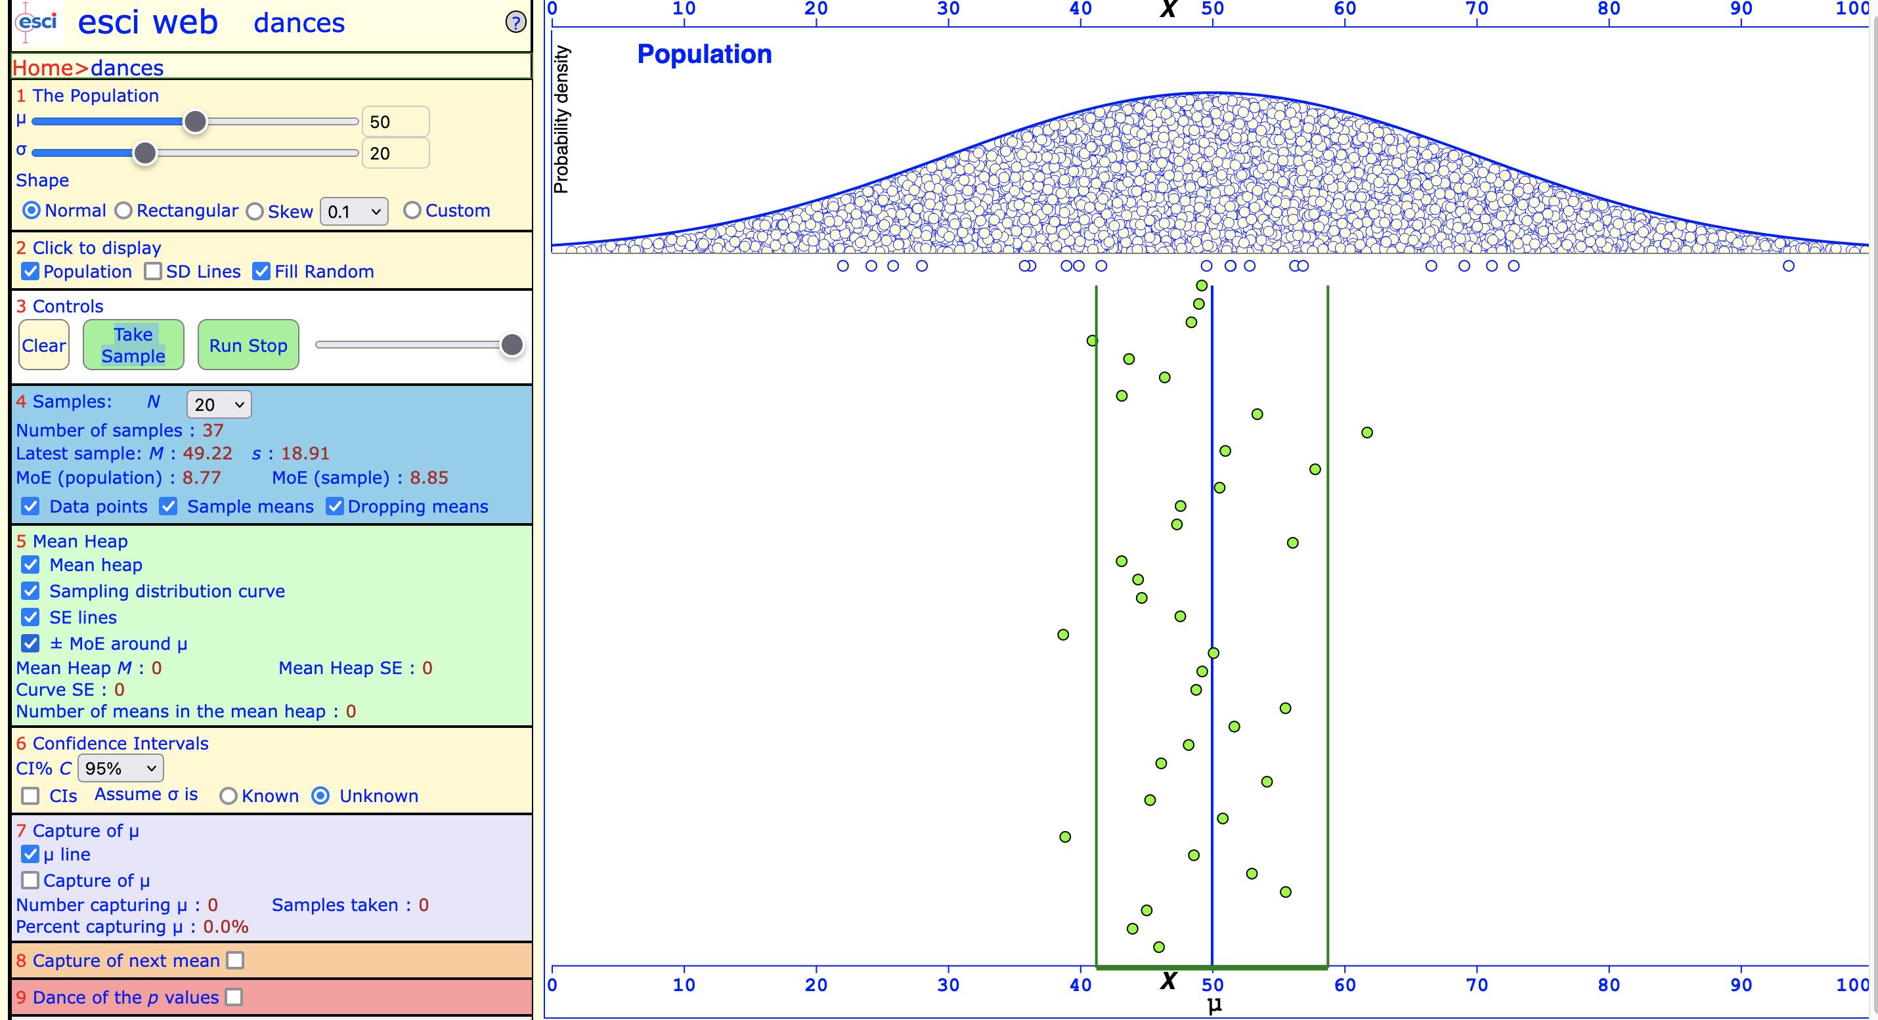
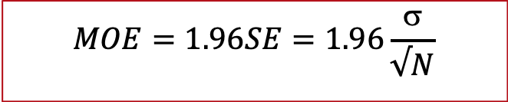
Margin of error
$$MOE=1.96SE=1.96\frac{\text{σ}}{√N}$$
1.96 SE from μ in each direction
Largest likely estimation error.
“Likely” usually means there’s a 95% chance that the estimation error is less than the MOE.
μ
👉

Slide 13
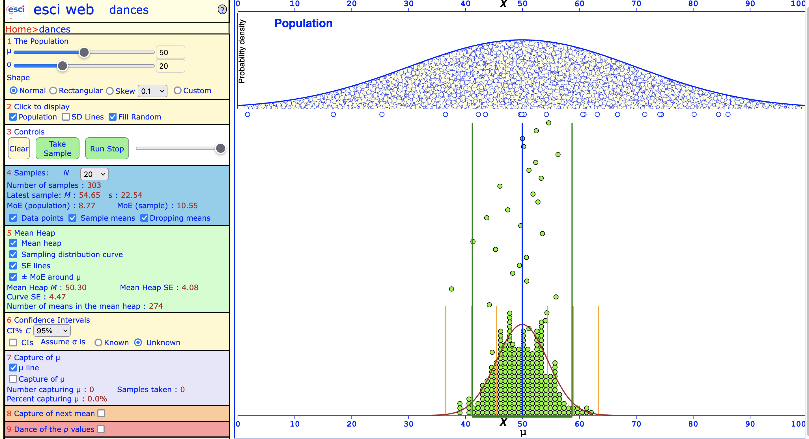
Most sample means fall within MOE boundaries.
Remember: 95% of observations will fall within 1.96 SE to the right and to the left of the mean μ
Notes:
Play around with N and Show the 95% rule by showing that most means fall within 95%.

Slide 14
Questions?

Slide 15

Confidence intervals
Cumming (2012)

Slide 16
What is a confidence interval?
The confidence interval is the interval we draw around our point estimate.
Confidence interval [M – MOE, M + MOE]
A range of values that we are 95% confident contains the population parameter.

Slide 17
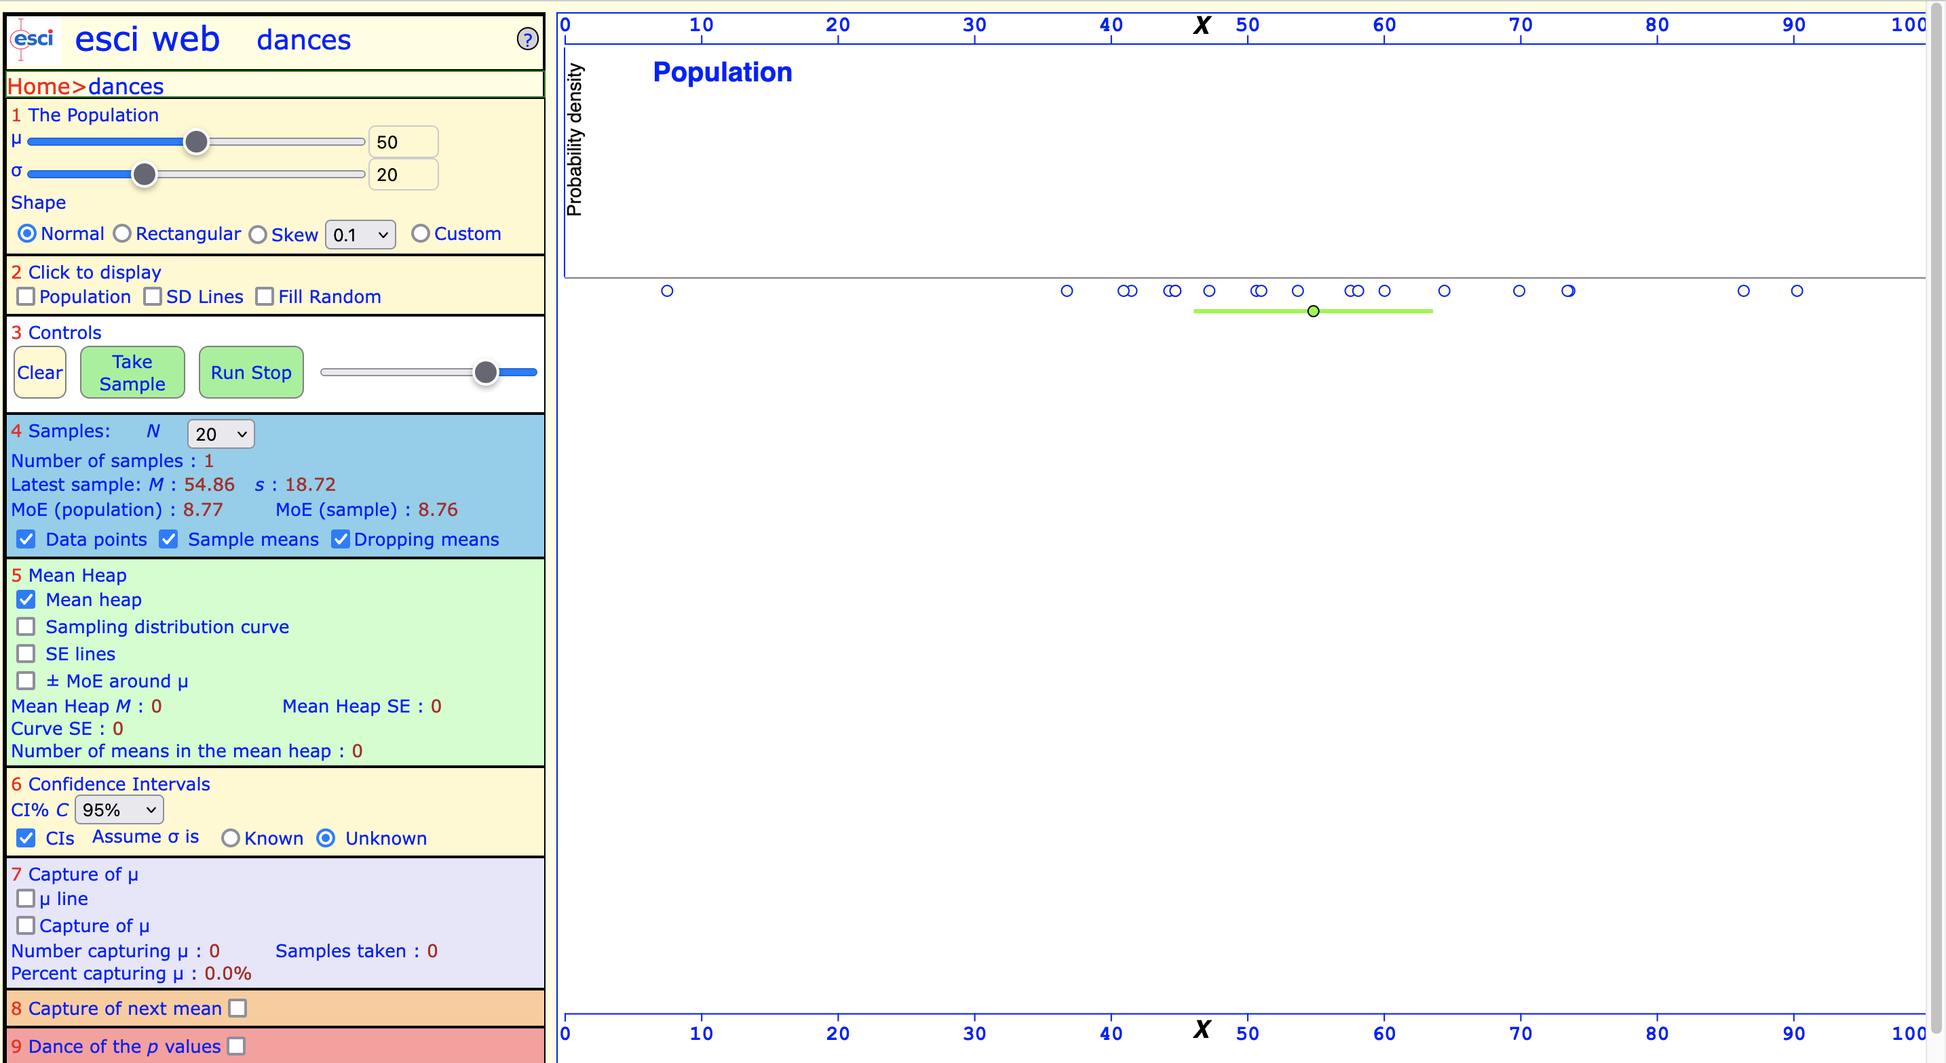
Confidence interval for one sample
In 36 out of 37 cases (97%)!
Confidence interval:
A range of values that we are 95% confident contains the population parameter.
We usually report 95% confidence level (but you can increase or decrease).
👉
👈

Slide 18
What is a confidence interval?
Confidence interval [M – MOE, M + MOE]
The values within the CI are plausible for the population parameter being estimated.
Values outside the interval the CI are relatively implausible.
The width of the CI tells us how precise our point estimate (M) is.
If the CI is narrow, then our estimation is very precise estimate.
If the CI is wide, then our estimation is less precise.

Slide 19
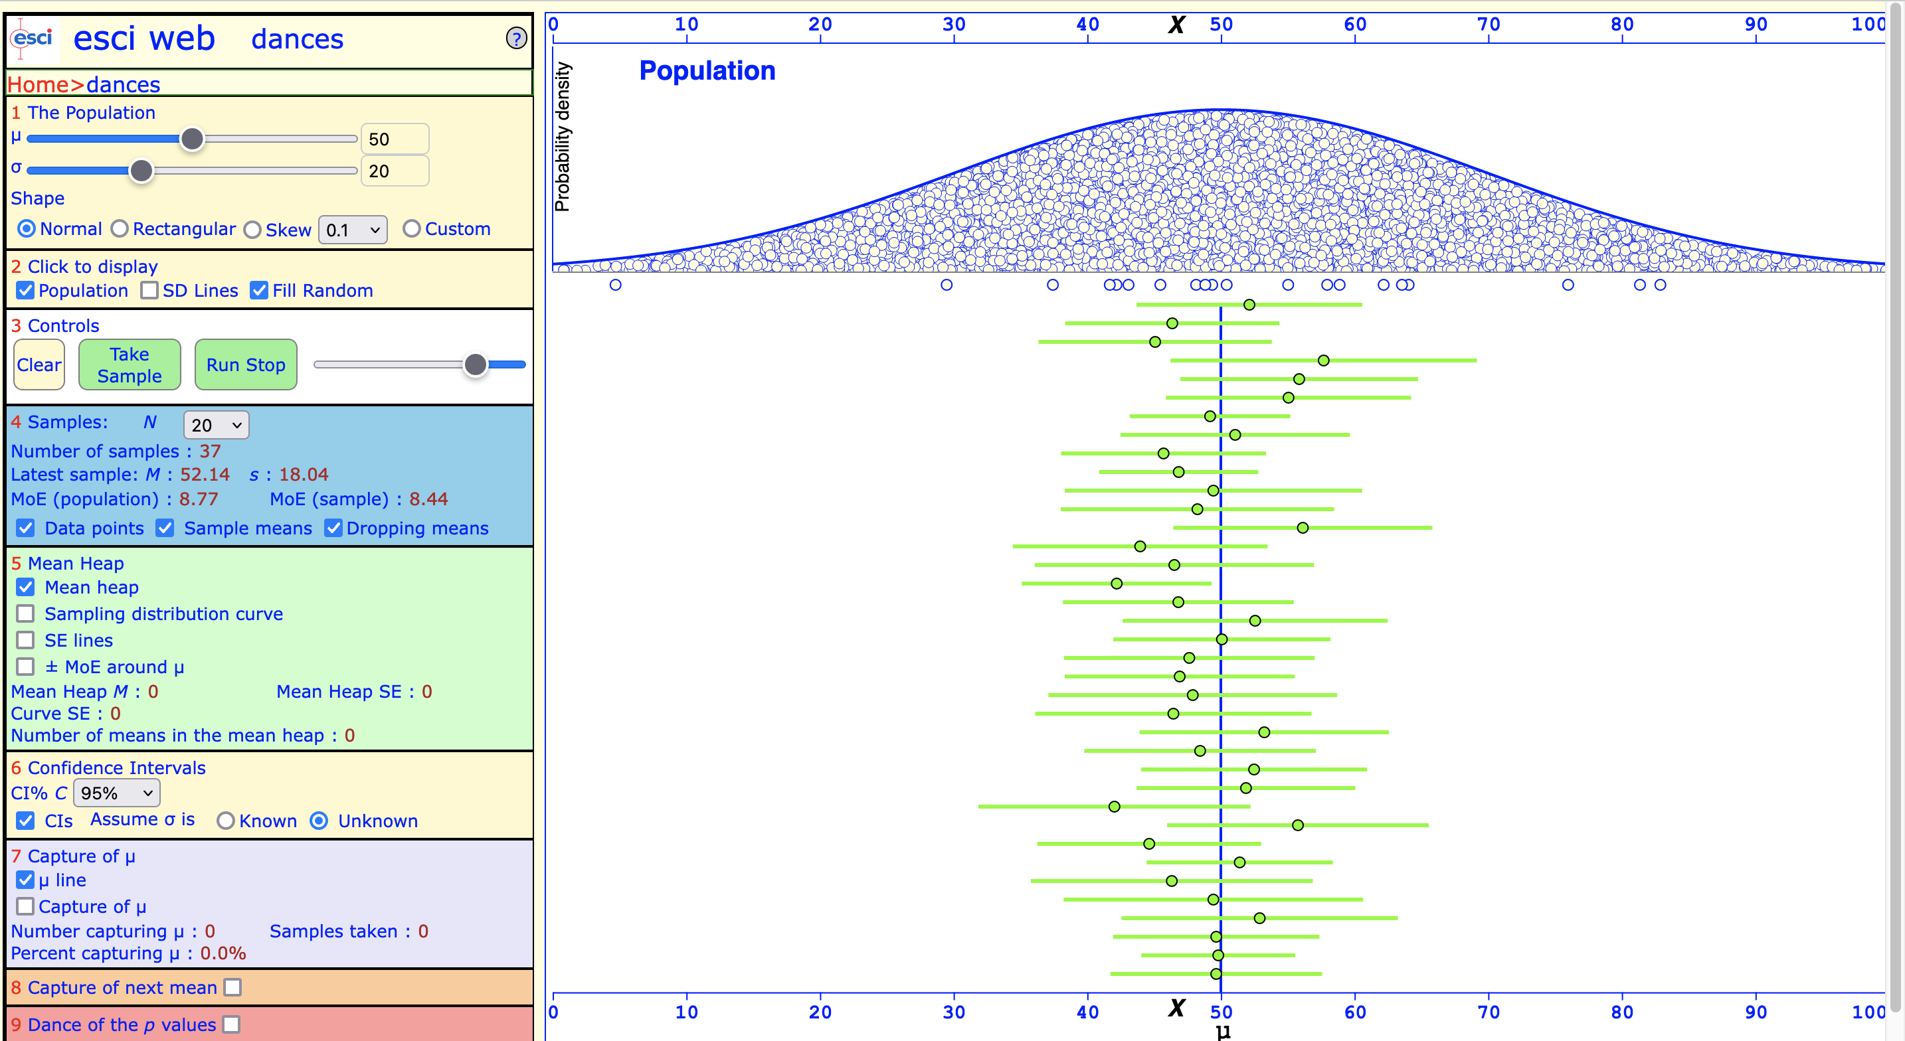
How often does the CI include the population parameter μ?
We drew 37 samples (green bubbles), and placed CIs around each (green intervals)

Slide 20
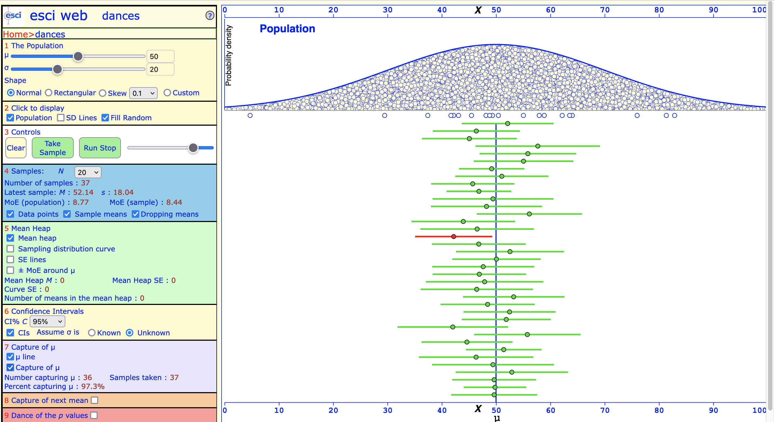
In 36 out of 37 cases (97%)!
Only one CI did not include the population parameter!
👉

Slide 21
It’s like magic (except it isn’t)
In 36 out of 37 cases (97%)!

Slide 22
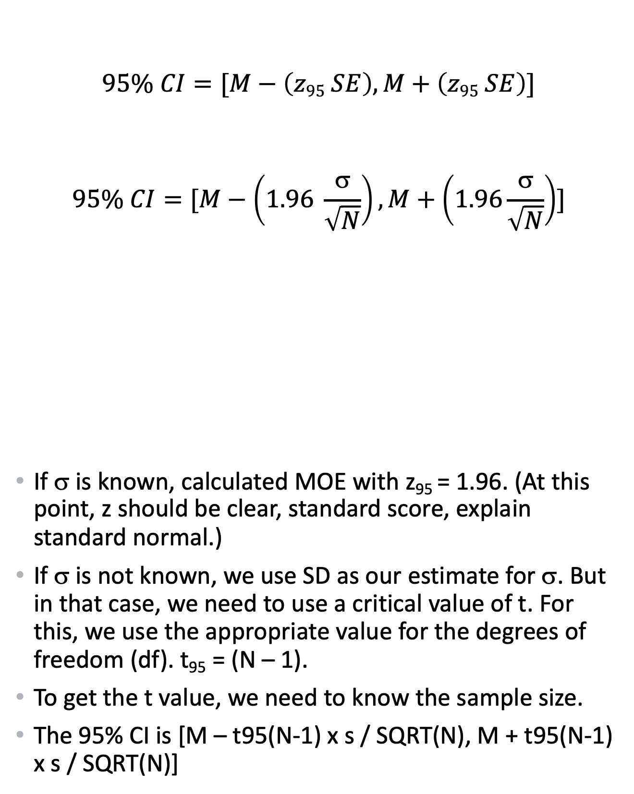
Calculating the 95% CI: When we know σ
Use z-distribution.
$$95\% CI=[M−\left(z95 SE\right), M+\left(z95 SE\right)]$$
$$95\% CI=[M−\left(1.96 \frac{\text{σ}}{\sqrt{N}}\right), M+\left(1.96\frac{\text{σ}}{\sqrt{N}}\right)]$$
If σ is known, calculated MOE with z₉₅ = 1.96. (At this point, z should be clear, standard score, explain standard normal.)
If σ is not known, we use SD as our estimate for σ. But in that case, we need to use a critical value of t. For this, we use the appropriate value for the degrees of freedom (df). t₉₅ = (N – 1).
To get the t value, we need to know the sample size.
The 95% CI is [M – t95(N-1) x s / SQRT(N), M + t95(N-1) x s / SQRT(N)]
Notes:
95% CI [M – 1.96 x σ/ SQRT(N), M + 1.96 x σ / SQRT(N)] Note: 1.96 from the z-distribution, 95% is always 1.96. [Explain where the 1.96 comes from]

Slide 23
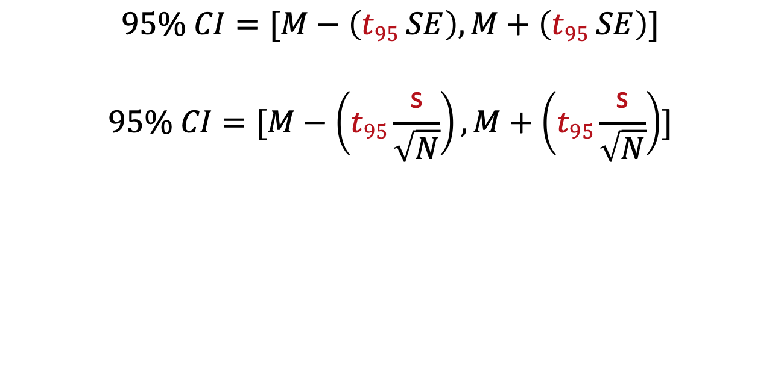
Calculating the 95% CI: When we do NOT know σ and when the sample size is small
$$95\% CI=[M−\left(t95 SE\right), M+\left(t95 SE\right)]$$
$$95\% CI=[M−\left(t95\frac{\text{s}}{\sqrt{N}}\right), M+\left(t95\frac{\text{s}}{\sqrt{N}}\right)]$$
Use sample SD of instead of (unknown) population SD σ.
And: Use t-distribution instead of z-distribution.
We didn’t plug in a number here as t₉₅ depends on the sample size. Look up the t-value for N-1 (df) via R.
Notes:
95% CI [M – 1.96 x σ/ SQRT(N), M + 1.96 x σ / SQRT(N)] Note: 1.96 from the z-distribution, 95% is always 1.96. [Explain where the 1.96 comes from]

Slide 24
The t-distribution
The t-distribution is the distribution we use when
we don’t know the population parameters (which is most common) and when
the sample size N is small (anything below 30).
Notes:
This varies from sample to sample (see dance of means).

Slide 25
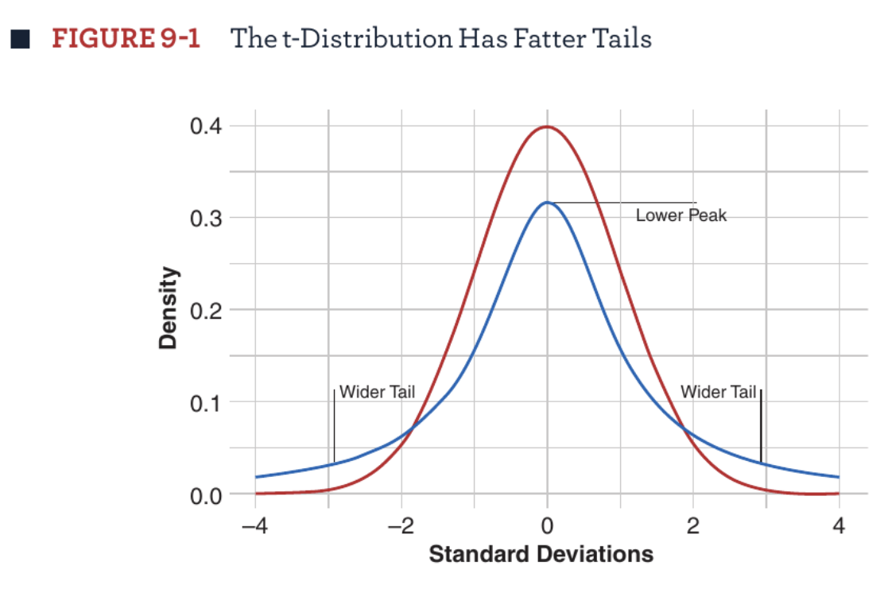
The t-distribution is more conservative
When we have observations in our sample, the t-distribution has fat tails, it’s more conservative than the z-distribution.
Brown (2021)

Slide 26
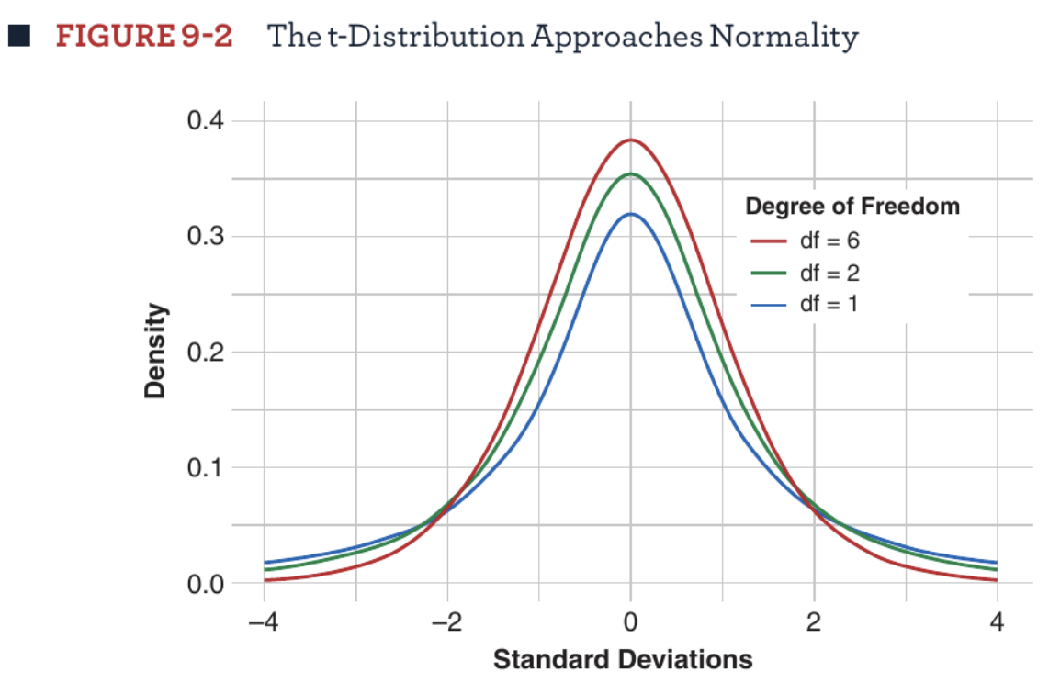
The t-distribution depends on sample size
The shape of the t-distribution looks different depending on the degrees of freedom (N – 1).
Brown (2021)

Slide 27
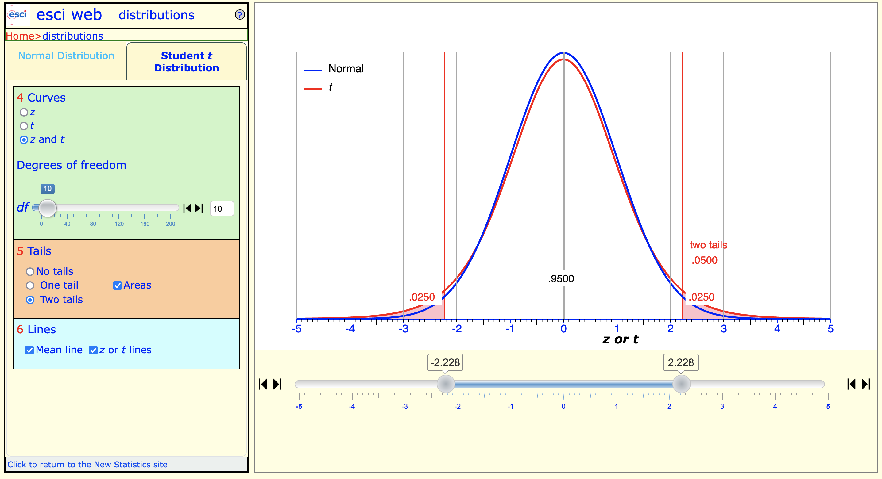
t-distribution, df = 10 (meaning: N = 11), t₉₅ = 2.228 for 95%
t₉₅ = 2.228

Slide 28
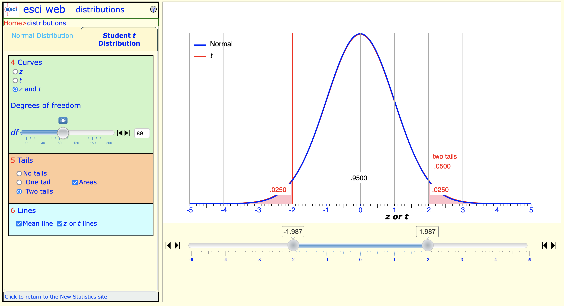
t-distribution, df = 89 (meaning: N = 90), t₉₅ = 1.987 for 95%
t₉₅ = 1.987

Slide 29
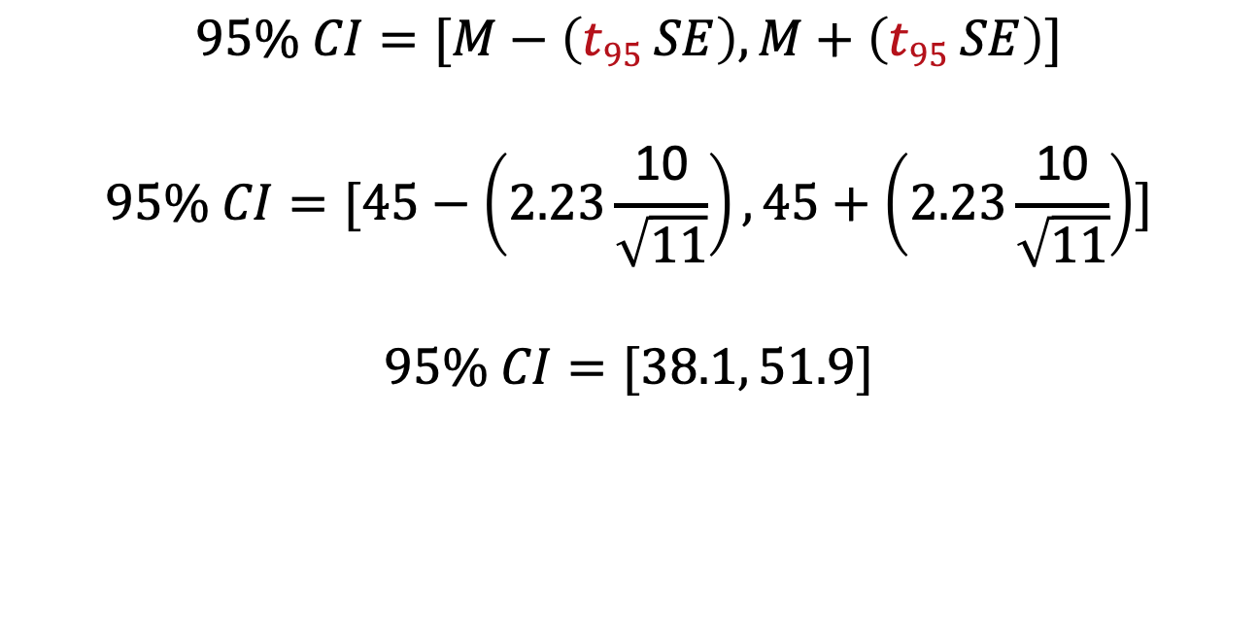
Example: Assume M = 45, SD = 10, N = 11. Then our CI calculation would look like this.
The t₉₅ value for df = 10 is 2.23.
$$95\% CI=[M−\left(t95 SE\right), M+\left(t95 SE\right)]$$
$$95\% CI=[45−\left(2.23\frac{\text{10}}{\sqrt{11}}\right), 45+\left(2.23\frac{\text{10}}{\sqrt{11}}\right)]$$
$$95\% CI=[38.1, 51.9]$$
38.1 is the lower limit (LL).
51.9 is the upper limit (LL).
Notes:
t-distribution, df = 10 (meaning: N = 11), t₉₅ = 2.23 for 95%

Slide 30
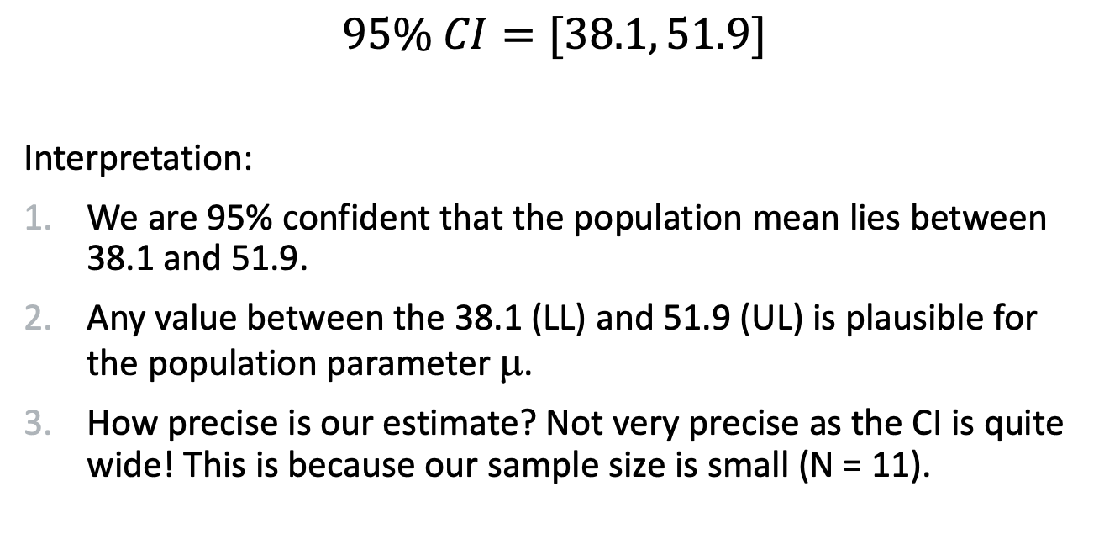
How do we interpret this?
$$95\% CI=[38.1, 51.9]$$
Interpretation:
We are 95% confident that the population mean lies between 38.1 and 51.9.
Any value between the 38.1 (LL) and 51.9 (UL) is plausible for the population parameter μ.
How precise is our estimate? Not very precise as the CI is quite wide! This is because our sample size is small (N = 11).
Notes:
t-distribution, df = 10 (meaning: N = 11), t₉₅ = 2.23 for 95%

Slide 31
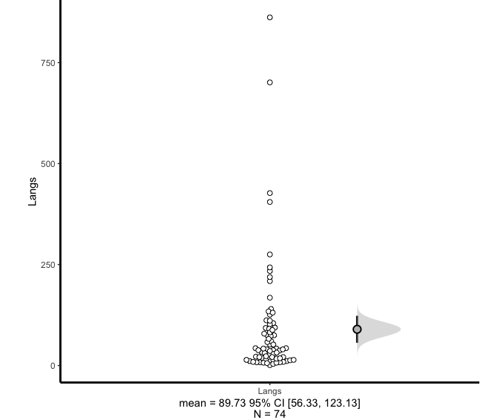
Practice calculating confidence intervals in R
Task 1:
CIs by hand
CIs using ESCI for R
The 74 observations, one bubble per country.
The 95% CI. The point estimate (M) is in the center.

Slide 32
The American Psychological Association recommends:
We should always report confidence intervals in our research.
CIs combine information about location and precision.
“Wherever possible, base discussion and interpretation of results on point and interval estimates” (APA, 2010, p. 34).
Notes:
Estimation thinking. Estimation thinking focuses on “how much” by focusing on point and interval estimates.
Dichotomous thinking: Focuses on making a choice between two mutually exclusive alternatives. Dichotomous reject-or-don’t-reject decisions of NHST tends to dichotomous thinking.

Slide 33
Example: Reporting CIs
Source APA website
APA Style recommends that confidence intervals be reported with brackets around the lower and upper limits.
Example:
“R² = .22, F(1, 32) = 7.33, p = .003, 95% CI [0.11, 1.23].”

Slide 34
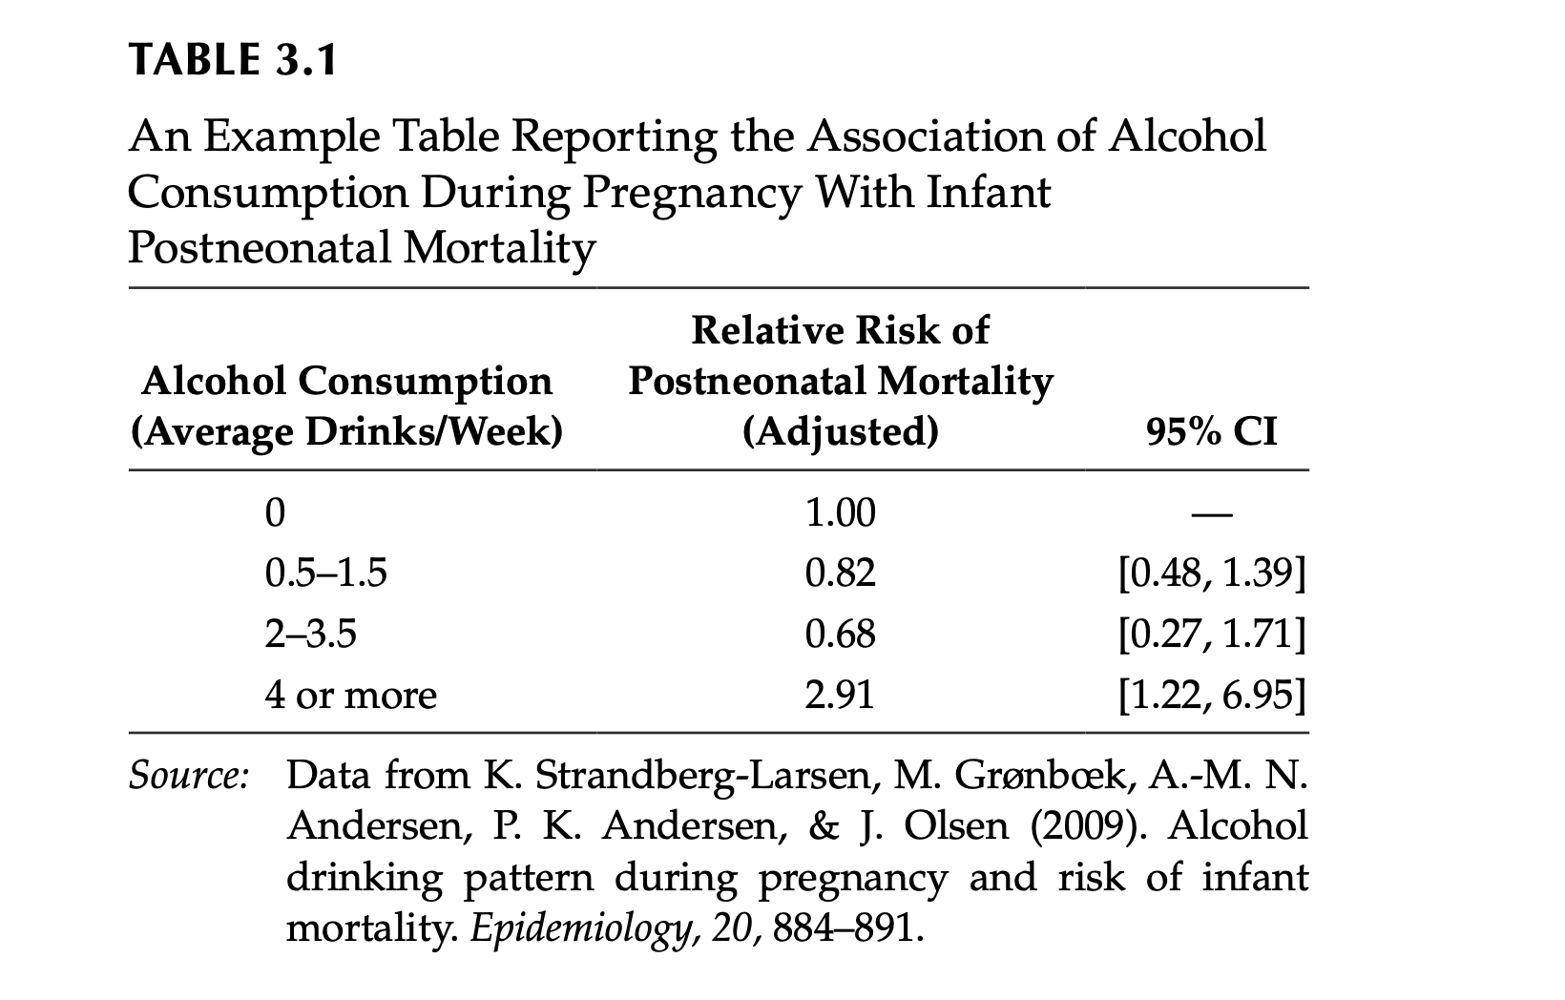
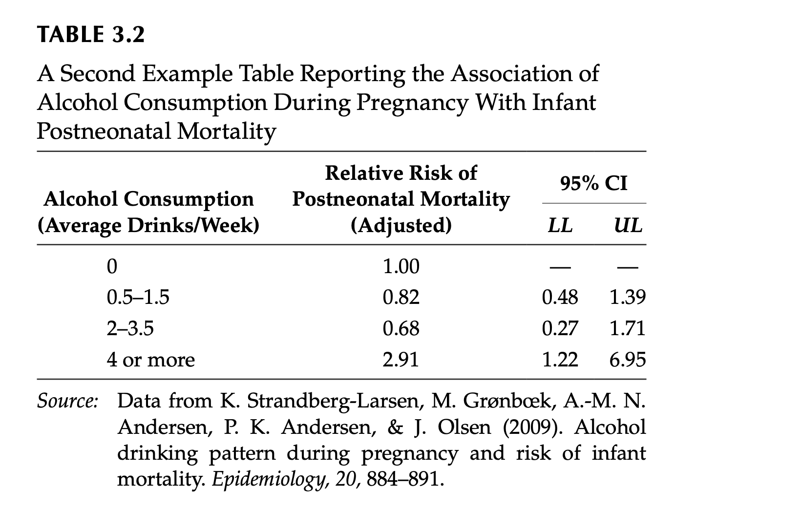
Example: Reporting CIs
From Cumming (2012)

Slide 35
Questions?
Cumming (2012)

Slide 36
Effect sizes

Slide 37
Effect sizes
Effect size measures are usually the main research results in our studies.
“Any of various measures of the magnitude or meaningfulness of a relationship between two variables. (…)” (APA Dictionary of Psychology, 2023)
Effect sizes should be the main focus of interpretation because they are the best information we have about the population.
Notes:
Effect sizes are interpreted as indicating the practical significance of a research finding.” (APA Dictionary of Psychology, 2023)

Slide 38
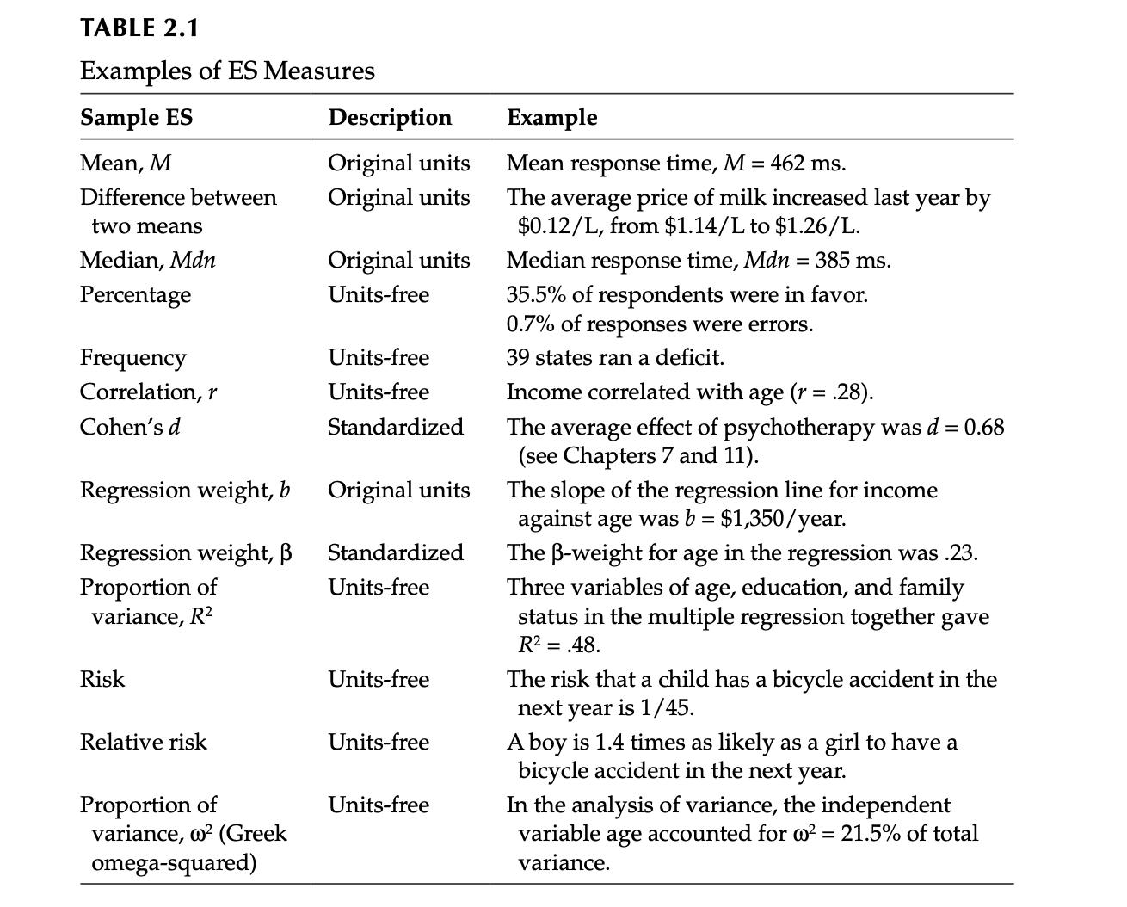
Effect sizes come in many shapes or forms.

Slide 39
Example: Performance of students on a language exam
Undergraduates (N = 100): M = 65.45, SD = 14.27.
Postgraduates (N = 100): M = 36.84, SD = 18.38.
Sample effect size (“raw”): M_{diff} = 32.25

Slide 40
Making (confident) claims about our population (Winter, 2019)
The magnitude of a difference
The variability in the data
The sample size
Notes:
The magnitude of a difference. The bigger the difference between two groups, the more you should expect there to be a difference in the population. (Here, the difference between means: M_{diff} = 32.25.)
The variability in the data. The less variability there is within the sample, the more certain you can be that you have estimated a difference accurately. (Here, the variance ratio is 1.66, so we can assume equal variances.)
The sample size. Bigger samples allow you to measure differences more accurately. (The sample size seems sufficient, each N = 100.)

Slide 41
Example: Performance of students on a language exam
The magnitude of a difference: Large, M_{diff} = 32.25
The variability in the data: Small, variance ratio 1.66.
The sample size: Large, N = 200.
We still do run a significance test, but these basic statistics might capture something about population.

Slide 42
Standardized effect sizes
Standardized measures of effect size are more interpretable across studies.
Can easily be used in meta-analyses.

Slide 43
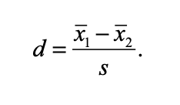
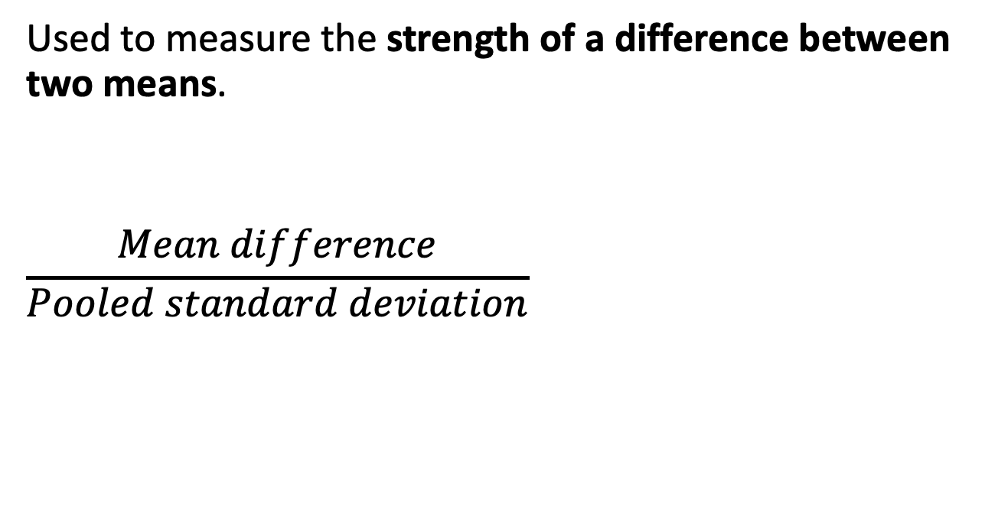
Standardized effect sizes: Cohen’s d
Used to measure the strength of a difference between two means.
$$\frac{Mean difference}{Pooled standard deviation}$$

Slide 44
How to interpret Cohen’s d
Cohen (1988): Interpreting the strength of the effect
d = 0.2 (small),
d = 0.5 (medium)
d = 0.8 (large)
But: Cohen also states that fields should have their own reference standards.

Slide 45
Cohen’s d for our earlier example
Sample effect size (raw): M_{diff} = 32.25
Cohen's d
d estimate: 1.96049 (large)
95 percent confidence interval:
lower upper
1.621161 2.299820

Slide 46
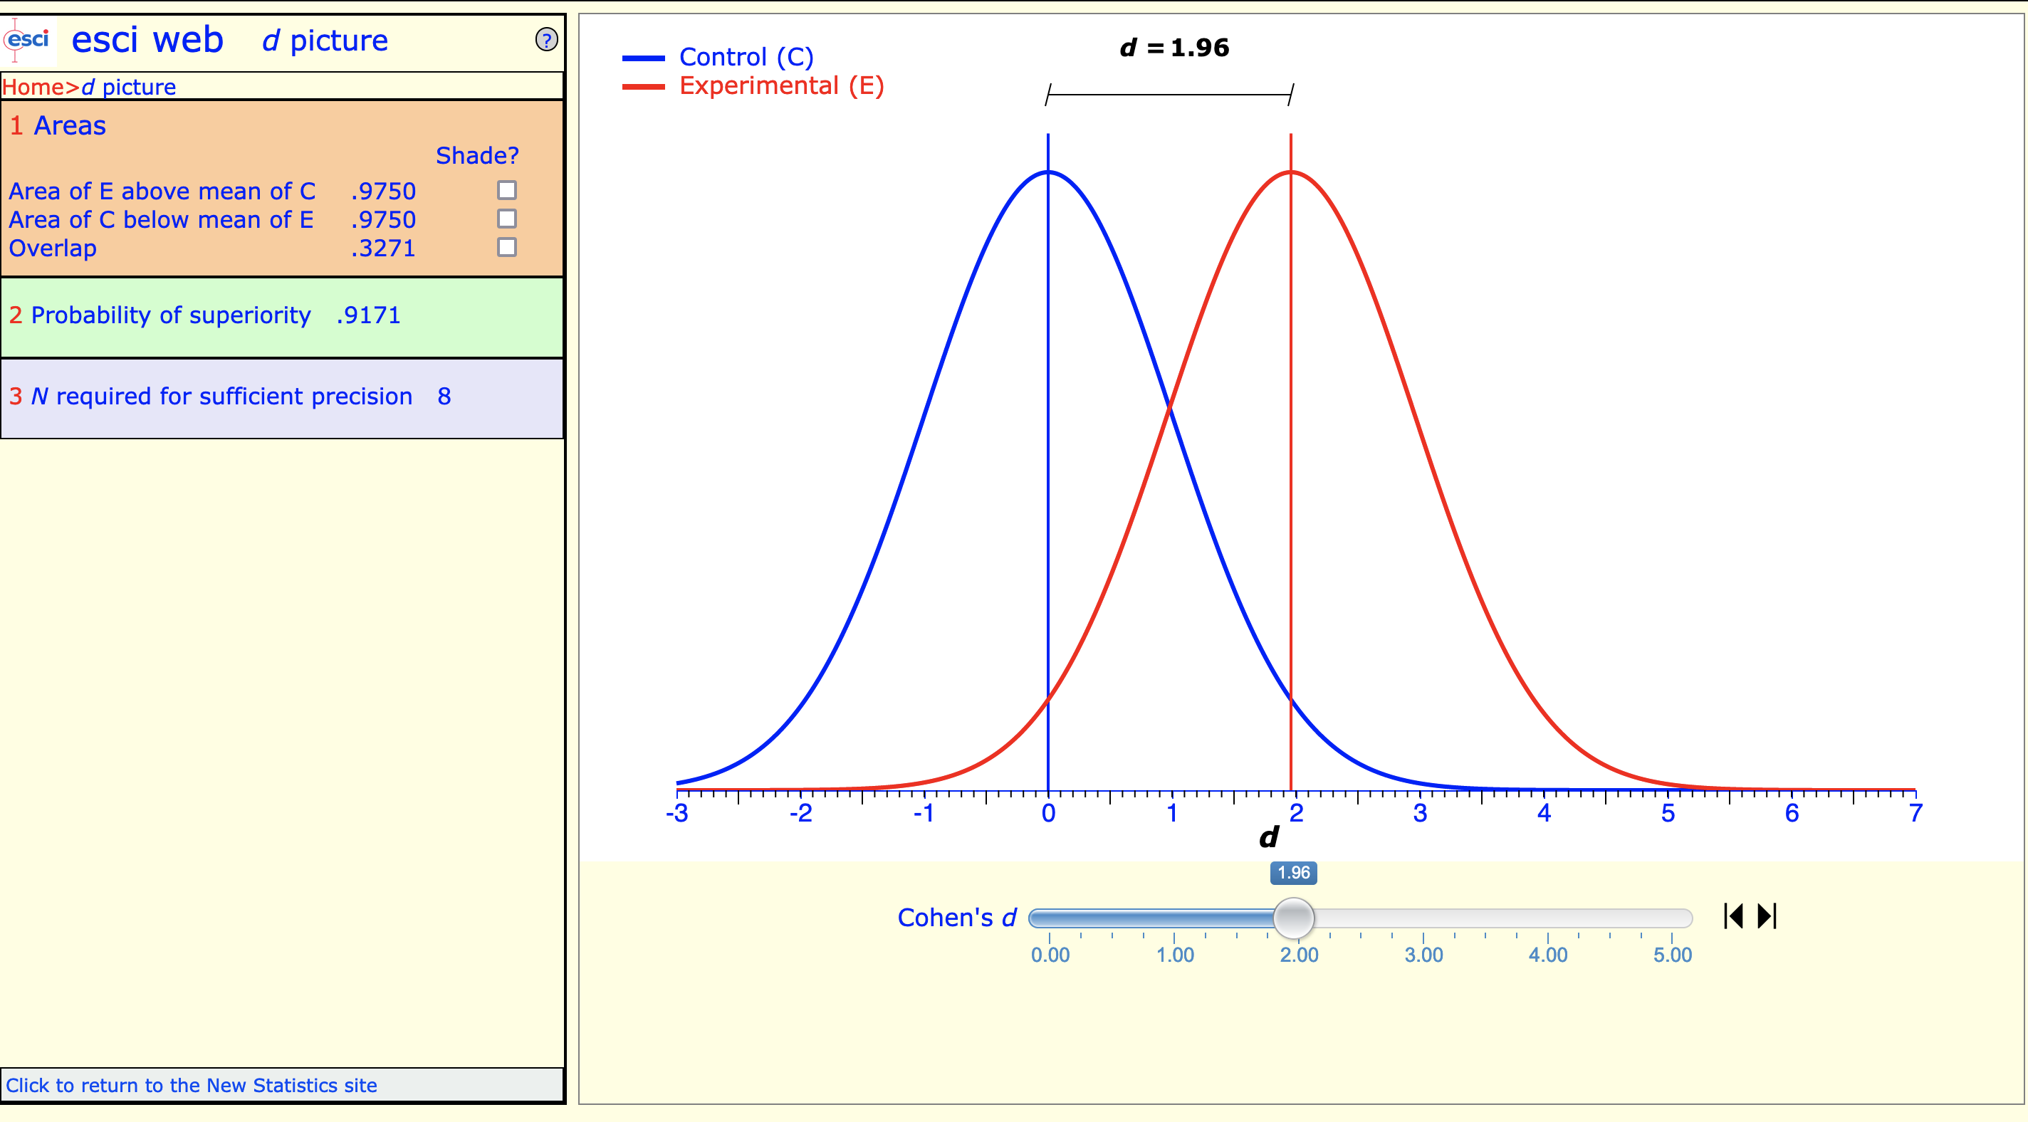
Cohen’s d = 1.96
👉

Slide 47
Questions?

Slide 48
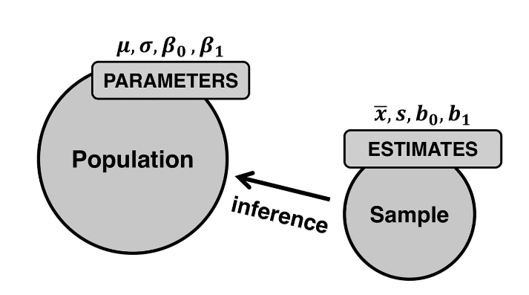
Null hypothesis significance testing (NHST)
Statistical inference allows us to draw conclusions about a population based on sample data.
We already looked at statistical estimation.
Today, we want to look another way of doing statistical inference: NHST.
Winter (2019)

Slide 49
NHST
Developed in the 1920s and 1930s
Key figures: Sir Ronald Fisher, Jerzy Neyman, Egon Pearson, and other statisticians.
The most widely used approach for statistical inference in the sciences
But…

Slide 50
Substantial controversy surrounds the use of NHST
NHST, used today, has grown over time out of distinct historical strands.
Combined several ideas, often conflicting ones.
NHST as a “incoherent mishmash of ideas” from Fisher on the one hand and Neyman and Pearson on the other hand (Gigerenzer, 2018)
“Mindless statistics” (Gigerenzer, 2004)
Notes:
For discussion: Cumming (2012, 2014), Morey, Hoekstra, Rouder, Lee, & Wagenmakers (2016), Vasishth & Gelman (2017), etc.
For discussion, see Gigerenzer (2018), Dienes (2008), Perezgonzalez (2015), Szucs & Ioannidis (2017)

Slide 51
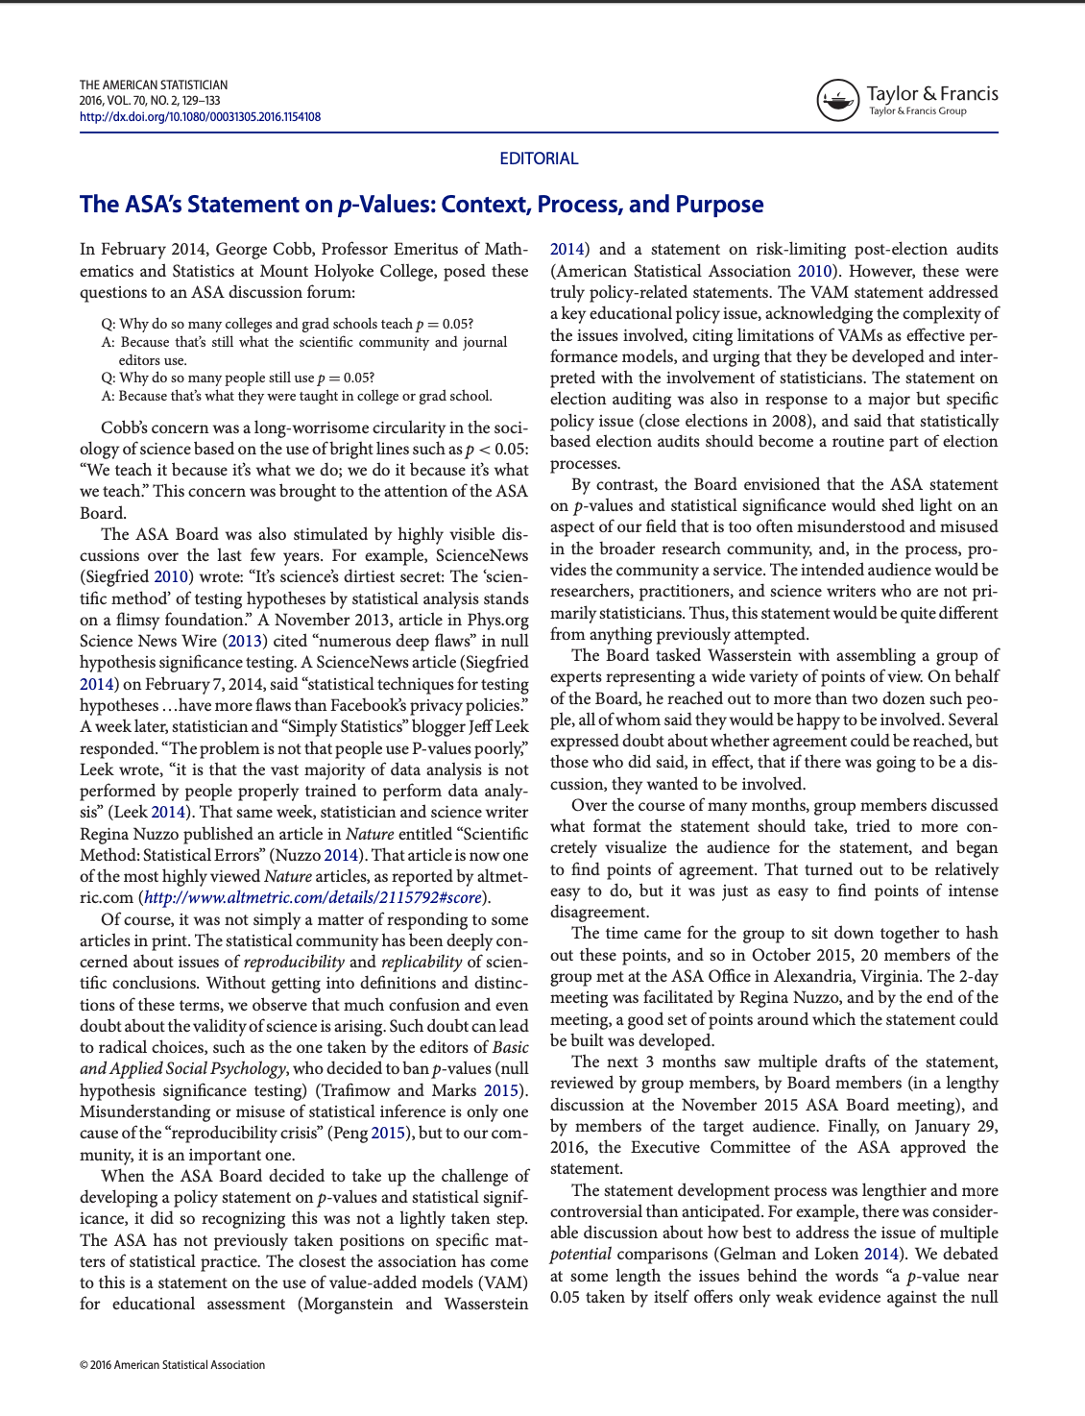
NHST statistics often misused or misunderstood
“Mindless statistics” (Gigerenzer, 2004)
ASA published the “ASA Statement on Statistical Significance and P-Values” (2017) to address the situation.
Many statisticians and other scientists have called for journals to stop publishing p-values.
Notes:
For discussion: Cumming (2012, 2014), Morey, Hoekstra, Rouder, Lee, & Wagenmakers (2016), Vasishth & Gelman (2017), etc.
For discussion, see Gigerenzer (2018), Dienes (2008), Perezgonzalez (2015), Szucs & Ioannidis (2017)

Slide 52
Classic steps in NSHT
Step 1: State the null hypothesis: H₀ μ1 = μ2
Step 2: Choose a significance level
Step 3: Select and apply the statistical test
Step 4: Calculate a p-value
Step 5: Report the results

Slide 53
Step 1: State the null hypothesis (H₀: μ1 = μ2)
Significance testing is used to decide whether a “null hypothesis” should be rejected (Fisher, 1935).
So, what is a null hypothesis?

Slide 54
Null hypothesis: H₀ μ1 = μ2
Null hypothesis (H₀):
When considering two (or more) population parameters, the null hypothesis is that there is no difference between the parameters in question.
If we observe a difference in our sample, then this is due to chance.
Example H₀ : There is no difference in the proportion of men and women smoking.

Slide 55
Alternative hypothesis H₁: μ1 ≠ μ2
We can state an alternative hypothesis, too, but this is not always done.
Alternative hypothesis (H₁):
There is a relationship between two (or more) variables in our sample data.
It is not due to chance alone.
Example H₁ : There is a difference in the proportion of men and women smoking.

Slide 56
Alternative hypothesis H₁: μ1 ≠ μ2
We can make our alternative hypothesis “directional”.
Example H₁ : The proportion of women smoking is greater (or smaller) than the proportion of men smoking.

Slide 57
Step 2: Choose a significance level
This will usually be .05. A convention.
“If one in twenty does not seem high enough odds, we may, if we prefer it, draw the line at one in fifty (the 2 per cent. point), or one in a hundred (the 1 per cent. point). Personally, the writer prefers to set a low standard of significance at the 5 per cent. point, and ignore entirely all results which fail to reach this level. A scientific fact should be regarded as experimentally established only if a properly designed experiment rarely fails to give this level of significance.” (Fisher, 1925)

Slide 58
Step 3: Select and apply the statistical test
Once the null hypothesis has been stated for the population, we look at our sample to measure how (in)compatible the actual data is with this initial assumption.
That is, when engaging in NHST, we measure the incompatibility of the data with the null hypothesis.
To do this, we select and apply an appropriate “significance test” (Fisher, 1925).
Notes:
“Critical tests of this kind may be called tests of significance, and when such tests are available we may discover whether a second sample is or is not significantly different from the first.” (Fisher, 1925, p. 43)

Slide 59
Selection of the significance test will depend on :
What kind of data is involved: continuous or categorical?
How many groups are being compared?
Are the group variances approximately equal?
Are the groups independent of one another?

Slide 60
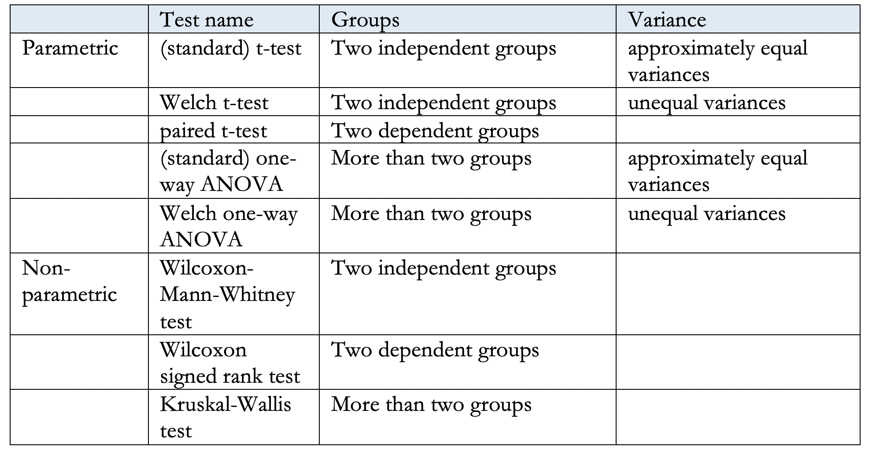
For example

Slide 61
Step 4: Calculate a p-value
What is the p-value?
The “result” means the test statistic, i.e. the output of a significance test.
The probability of getting the observed result, or a more extreme one, if the null hypothesis μ₁ = μ₂ is true.

Slide 62
Step 4: Calculate a p-value
“An effect is said to be statistically significant when [the] p-value is so small that it is held to be implausible that such a difference could have arisen by chance.” (Macdonald, 2004, p. 197)
A statistically significant result is simply one that would rarely be observed if the null hypothesis were true.

Slide 63
Step 4: Calculate a p-value
If we set the significance level p < .05:
If we repeat an experiment 100 times (always drawing random, independent samples), and the null hypothesis μ₁ = μ₂ were true each time, we would see the same (or a more extreme) result no more than 5 times.

Slide 64
The p-value tells us whether or not to reject the null hypothesis:
If p < .05, we reject the null hypothesis and declare the result “statistically significant”.
If p > .05, then we don’t reject the null hypothesis and call the result “not statistically significant”.

Slide 65
“Dichotomous thinking” (Cumming, 2012)
If the results are not statistically significant, we need to “ignore entirely all results which fail to reach this level”!
(Fisher, 1925)
We either accept or reject.

Slide 66
Importance of replication
Any single study can be wrong as a consequence of an improbable event occurring (5% of the times).
This is why we need to replicate studies.
“No isolated experiment, however significant in itself, can suffice for the experimental demonstration of any natural phenomenon; for the ‘one chance in a million’ will undoubtedly occur, with no less and no more than its appropriate frequency, however surprised we may be that it should occur to us.” (Fisher, 1935)

Slide 67
Step 5: Report the results of the significance test
Generally, we need to report the two or three items:
the test statistic (e.g., the t-value)
the degrees of freedom (where they exist),
the p-value
We should also report the “statistic of interest” (the effect size measures) and its 95% confidence interval.

Slide 68
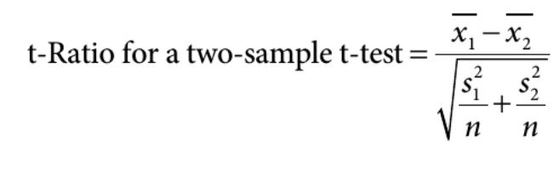
Example: The t-test
We use t-tests to compare two dependent or independent samples.
There are different types of t-tests.
For example, the formula for the Welch t-test looks like this:
👉

Slide 69
Example: The t-test
In our example with UG and PG scores on a language exam:
t = 13.863
To compute the t-value, we need:
the means for both groups,
the standard deviations, and
the sample sizes.
Large t-value suggests the groups are different.
Small value indicates the groups are similar.

Slide 70
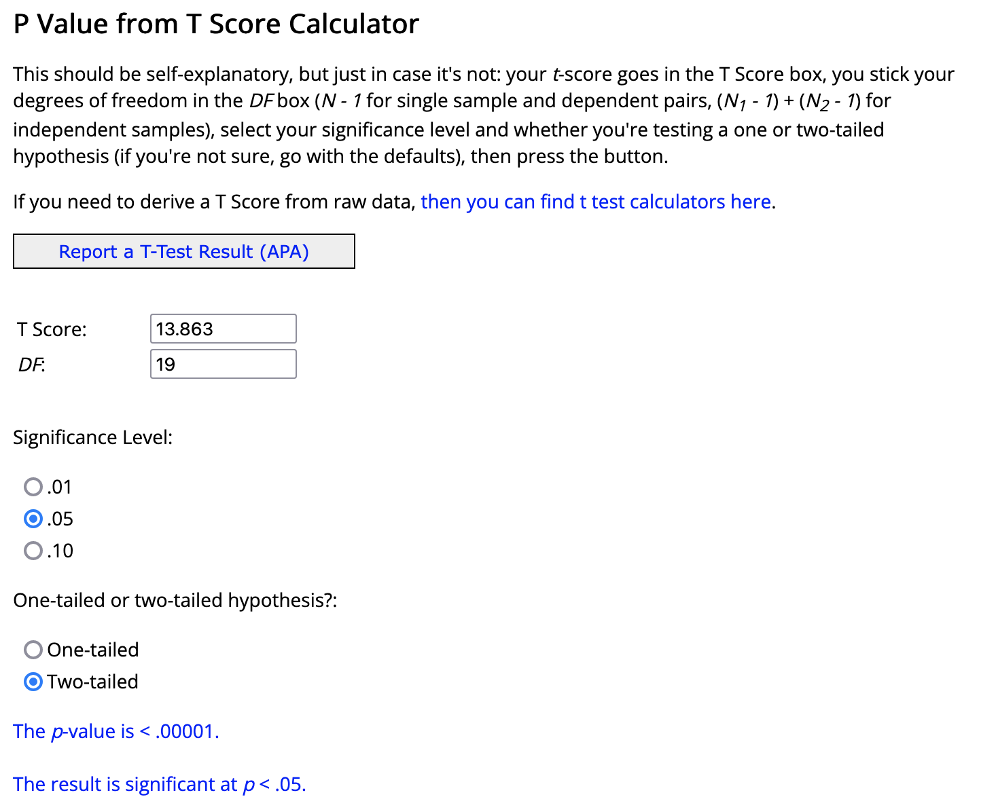
Use the t-distribution to check how probable your t-value is.
We will do with R in the handout, but there online calculators if you want to check values quickly.
👉
Notes:
If the null hypothesis is true (that there is no difference between UG and PG scores on the language exam), then a t-value below 2.09 is very improbable. We can reject the H₀.

Slide 71
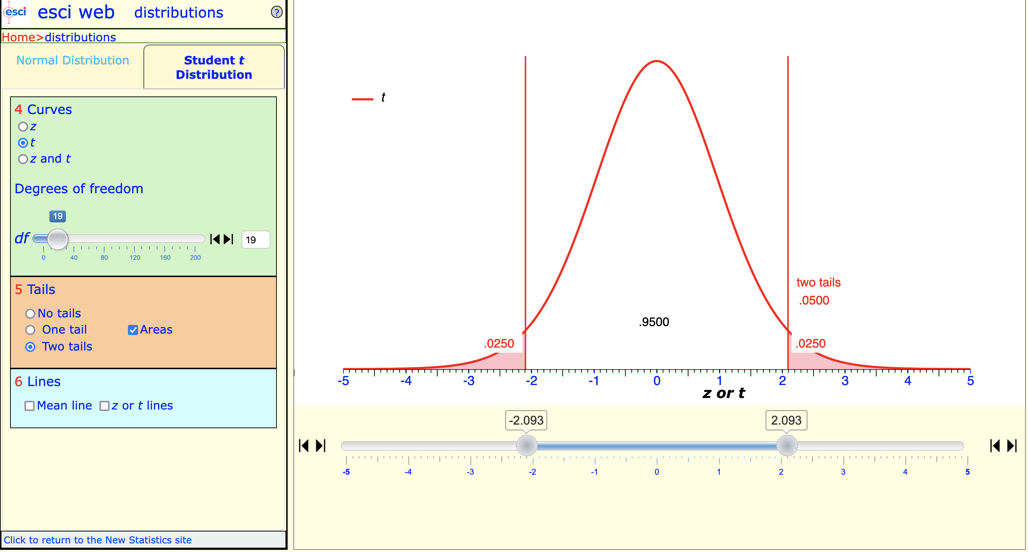
With df = 19, any t-value ≤ 2.09 is very improbable (less than 5% chance)
👉
Notes:
If the null hypothesis is true (that there is no difference between UG and PG scores on the language exam), then a t-value below 2.09 is very improbable. We can reject the H₀.

Slide 72
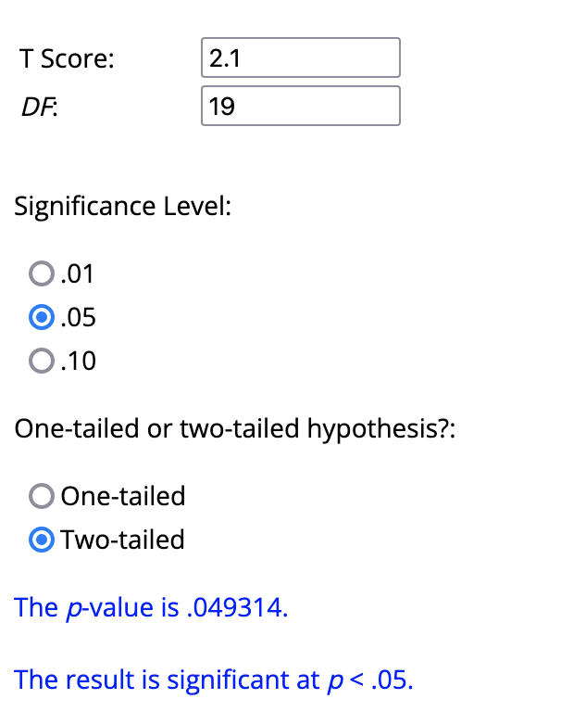
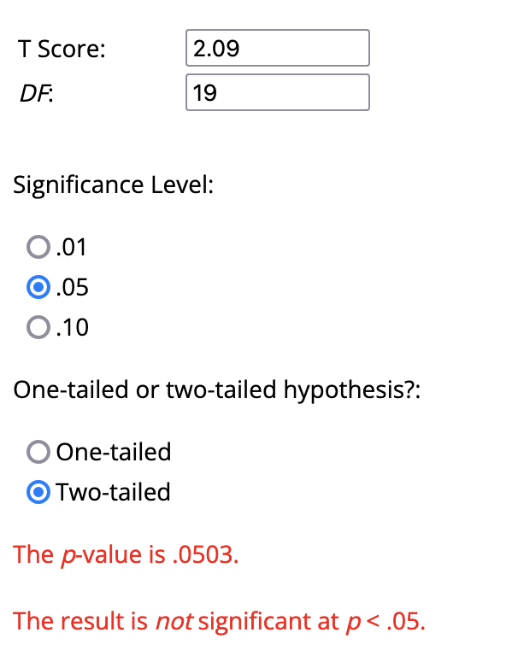
Compare t = 2.1 and t = 2.09
👉
👉
With df = 19, any t-value ≤ 2.09 is very improbable (less than 5% chance) if the null hypothesis is true.
t ≤ 2.09 are incompatible with the null hypothesis being true (if df = 19).
So, we reject the null hypothesis!
Notes:
If the null hypothesis is true (that there is no difference between UG and PG scores on the language exam), then a t-value below 2.09 is very improbable. We can reject the H₀.

Slide 73
Our earlier example
Sample effect size (raw): M_{diff} = 32.25
Standardized effect size: Cohen’s d = 1.96
Welch Two Sample t-test
t = 13.863, df = 186.55, p-value < 2.2e-16
95 percent confidence interval:
27.66306 36.84265
sample estimates:
mean of x mean of y
65.45040 33.19754
p = 0.00000000000000022

Slide 74
Let’s report our results
We need to report
either the two sample means M₁ and M₂ (UG and PG scores) or the mean difference (M_{diff}),
the SDs associated with two means, and
the 95% CI.
Ideally also a standardized effect size like Cohen’s d.
These tells us something about the practical significance our results.

Slide 75
Let’s report our results
In addition, we report the results of statistical significance.
Here, we report:
the t-value,
the degrees of freedom,
the p-value.
PS: p-values should be reported precisely (p = .234), except when they are lower than p < 0.01 or p < 0.001, respectively.

Slide 76
A possible report
“In the language exam, the mean score for undergraduate students was 65.45 (SD = 14.27) and the mean score for postgraduate students 36.84 (SD = 18.38). This difference represents a large effect, Cohen’s d = 1.96, 95% [1.62, 2.30].
A Welch t–test further showed that difference between undergraduate and postgraduate performance was statistically significant, t(187) = 13.86, p < .001.”

Slide 77
Questions?

Slide 78
Quantitative Research Methods
February 27, 2023
Professor Patrick Rebuschat
p.rebuschat@lancaster.ac.uk
Notes:
Section title slide.

